Slide 1




Slide 2
A complete path from R&D to real-world energy systems
PRESENTATION OVERVIEW
Company & Production
Solar Thermal
PVT Technology & Testing
01
02
03
R&D centre, manufacturing capabilities and production equipment
Collector technologies, certification and thermal installations
Hybrid collectors, product variants and independent test results
Reference Projects
Integrated Systems & R&D
04
05
Selected installations across Europe and international markets
District heating, system design, EU projects and scientific partners
pvt-hybrid.eu • info@pvt-hybrid.eu • +420 774 683 019
02

Slide 3
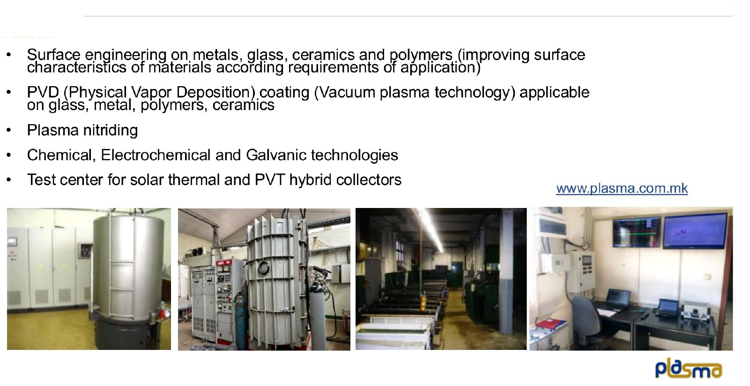
Plasma R&D Centre — At a Glance
01 COMPANY & PRODUCTION
pvt-hybrid.eu • info@pvt-hybrid.eu • +420 774 683 019
03

Slide 4
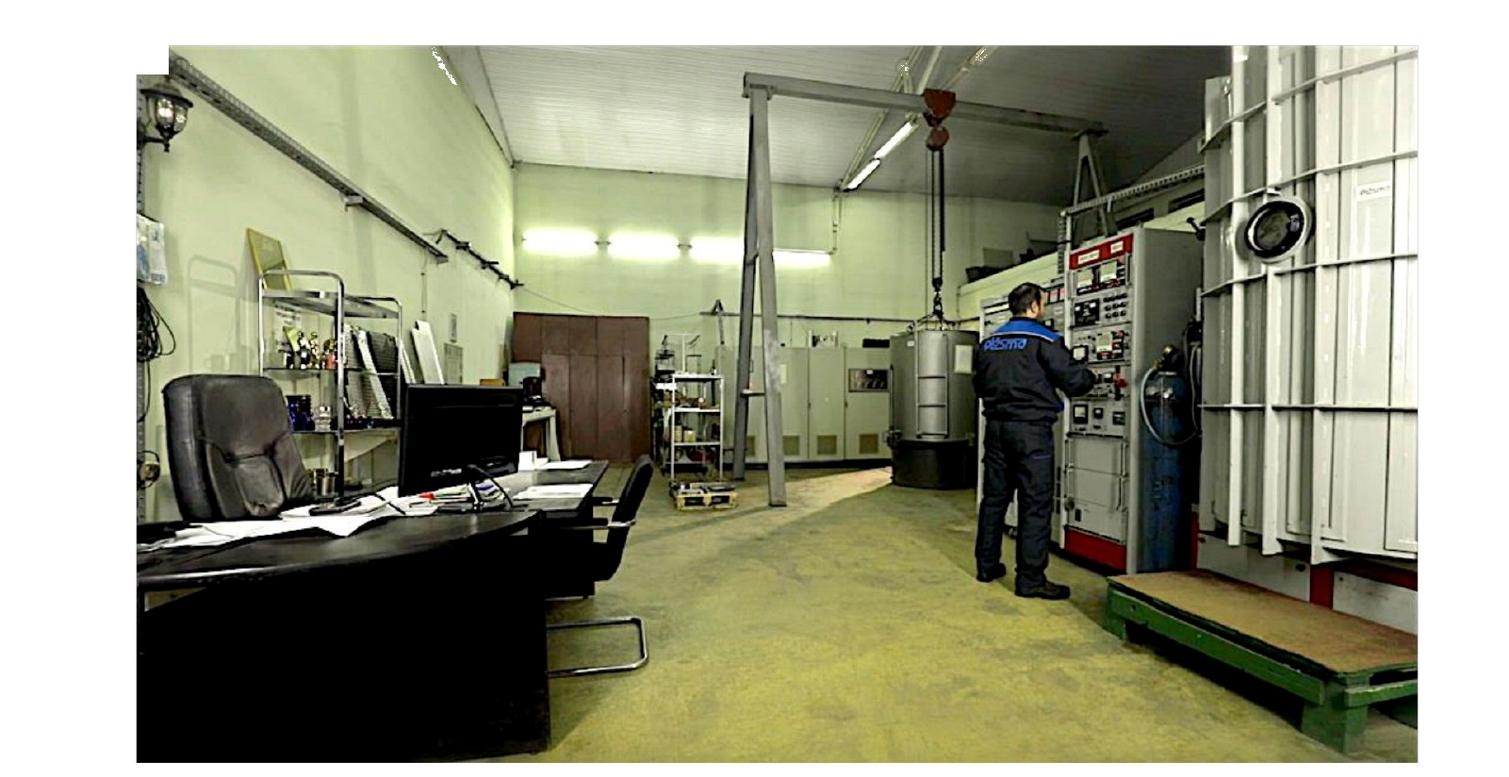
Plasma Production Facilities
01 COMPANY & PRODUCTION
pvt-hybrid.eu • info@pvt-hybrid.eu • +420 774 683 019
04

Slide 5
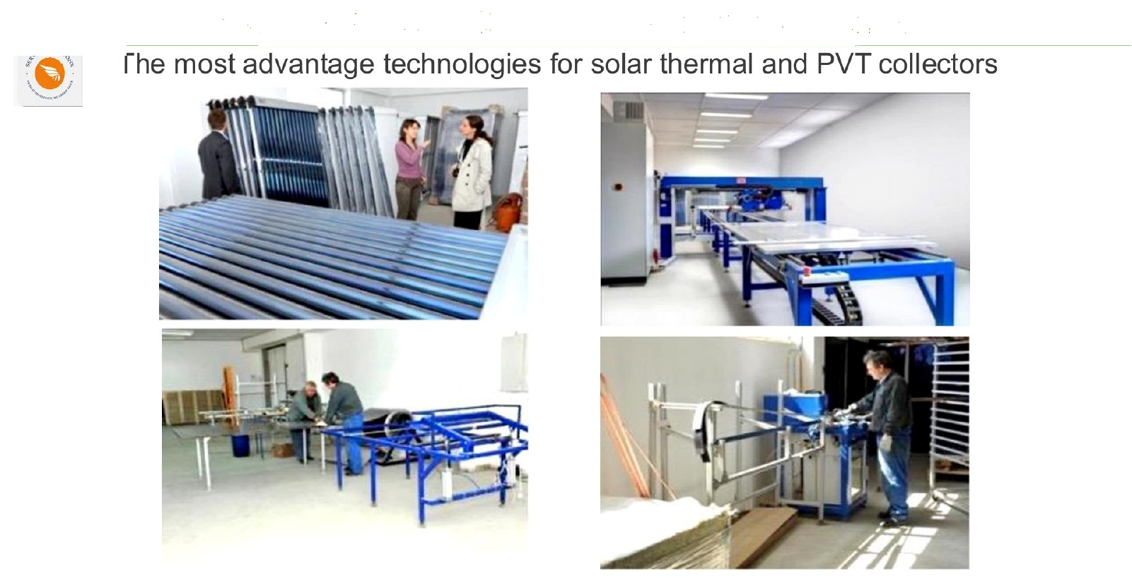
Advanced Manufacturing for Solar Thermal & PVT
01 COMPANY & PRODUCTION
pvt-hybrid.eu • info@pvt-hybrid.eu • +420 774 683 019
05

Slide 6
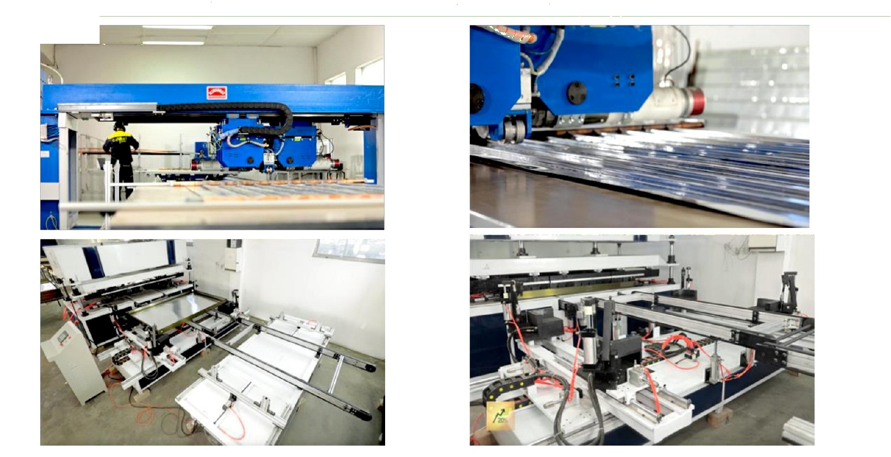
Selected Production Equipment
01 COMPANY & PRODUCTION
pvt-hybrid.eu • info@pvt-hybrid.eu • +420 774 683 019
06

Slide 7
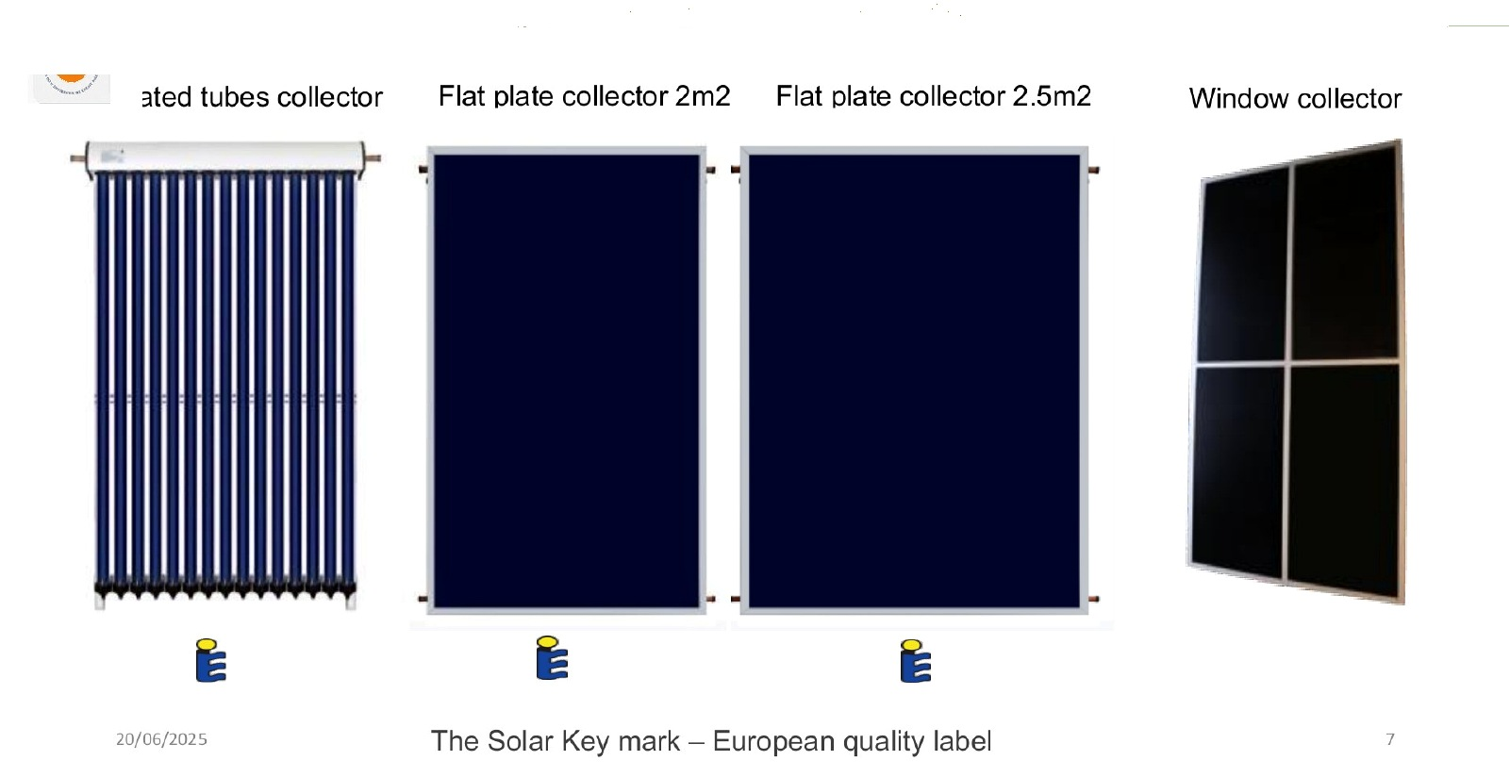
High-Efficiency Solar Thermal Collector Types
02 SOLAR THERMAL
pvt-hybrid.eu • info@pvt-hybrid.eu • +420 774 683 019
07

Slide 8
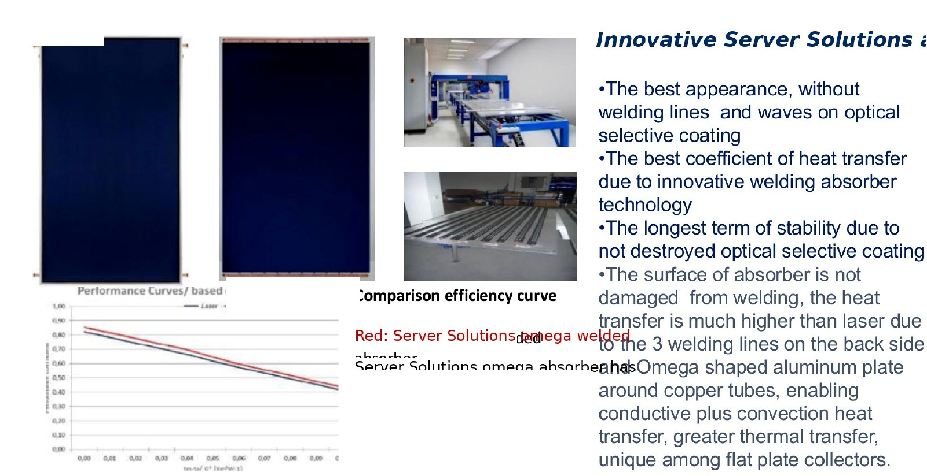
Flat-Plate Collectors & Omega Absorber Advantages
02 SOLAR THERMAL
UP TO 8% HIGHER EFFICIENCY
Omega absorber design compared with conventional laser-welded absorbers.
pvt-hybrid.eu • info@pvt-hybrid.eu • +420 774 683 019
08

Slide 9
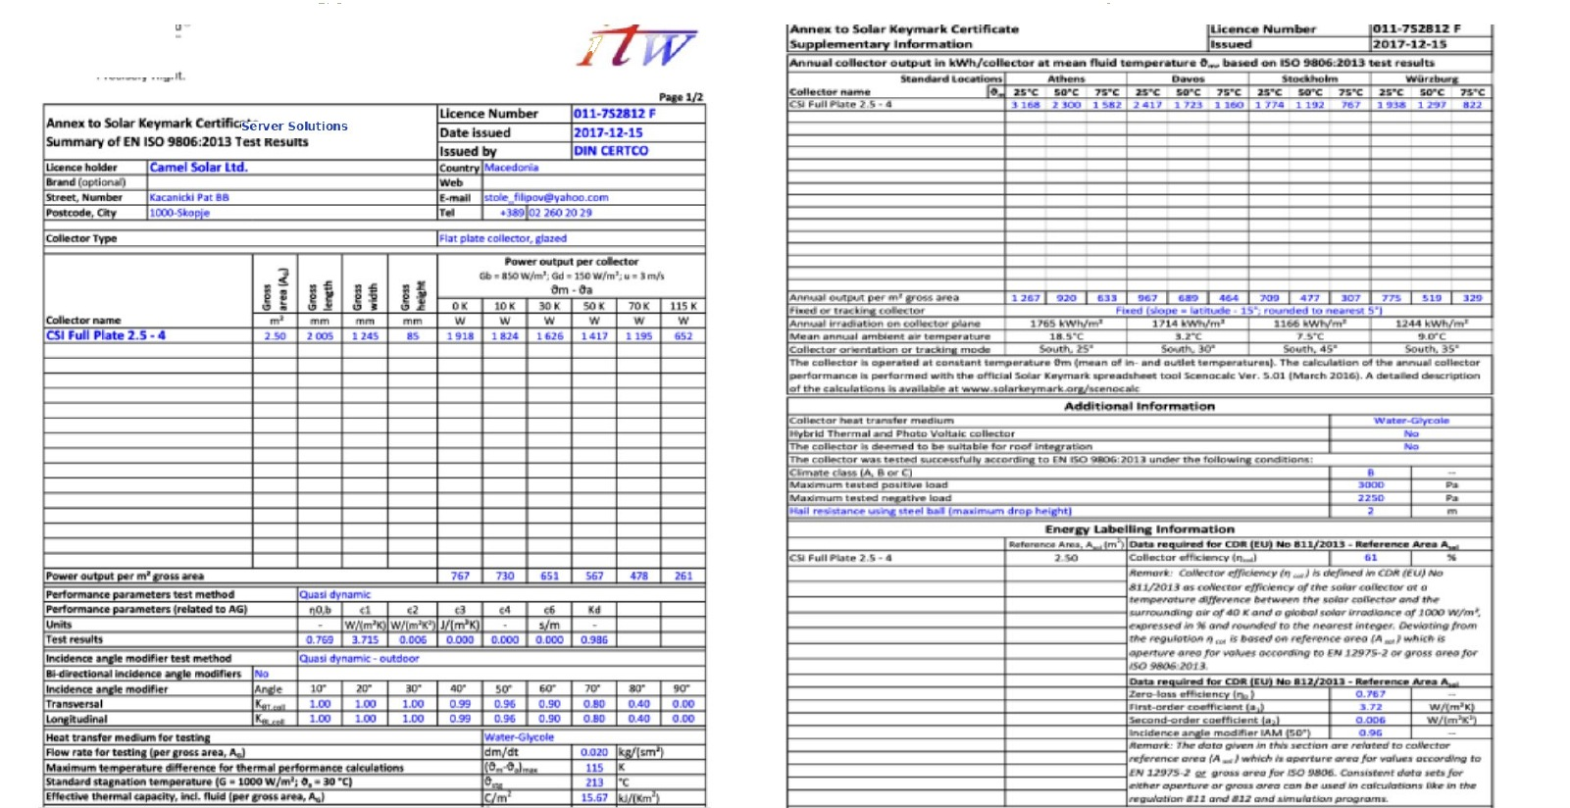
Solar Keymark Certification — Flat-Plate Collector
02 SOLAR THERMAL
pvt-hybrid.eu • info@pvt-hybrid.eu • +420 774 683 019
09

Slide 10
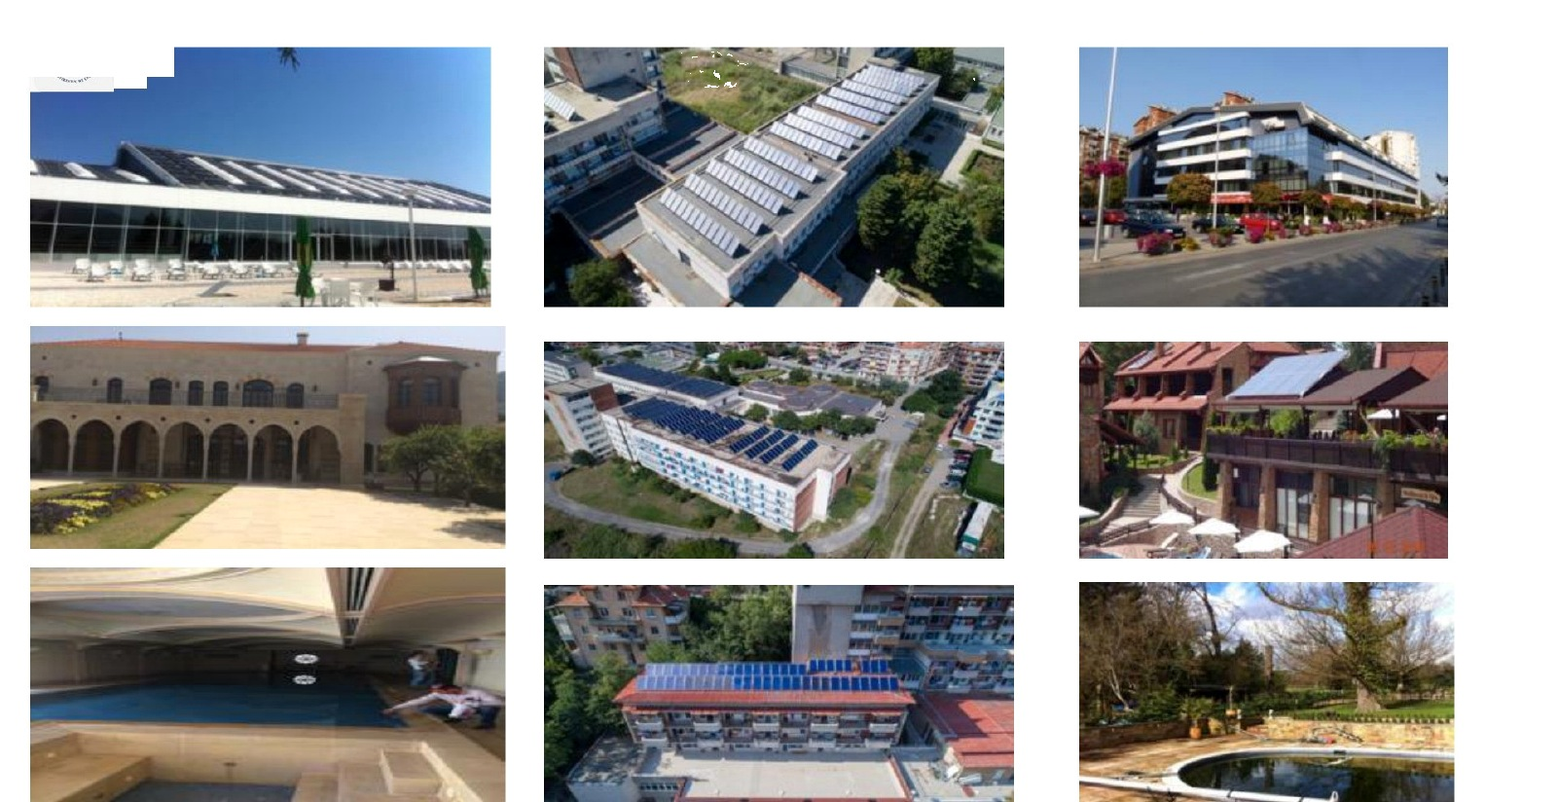
Selected Solar Thermal Installations
02 SOLAR THERMAL
pvt-hybrid.eu • info@pvt-hybrid.eu • +420 774 683 019
10

Slide 11
03
PVT COLLECTOR
TECHNOLOGY
Hybrid electrical and thermal output from a single collector platform.
SERVER SOLUTIONS
pvt-hybrid.eu • info@pvt-hybrid.eu • +420 774 683 019
11

Slide 12
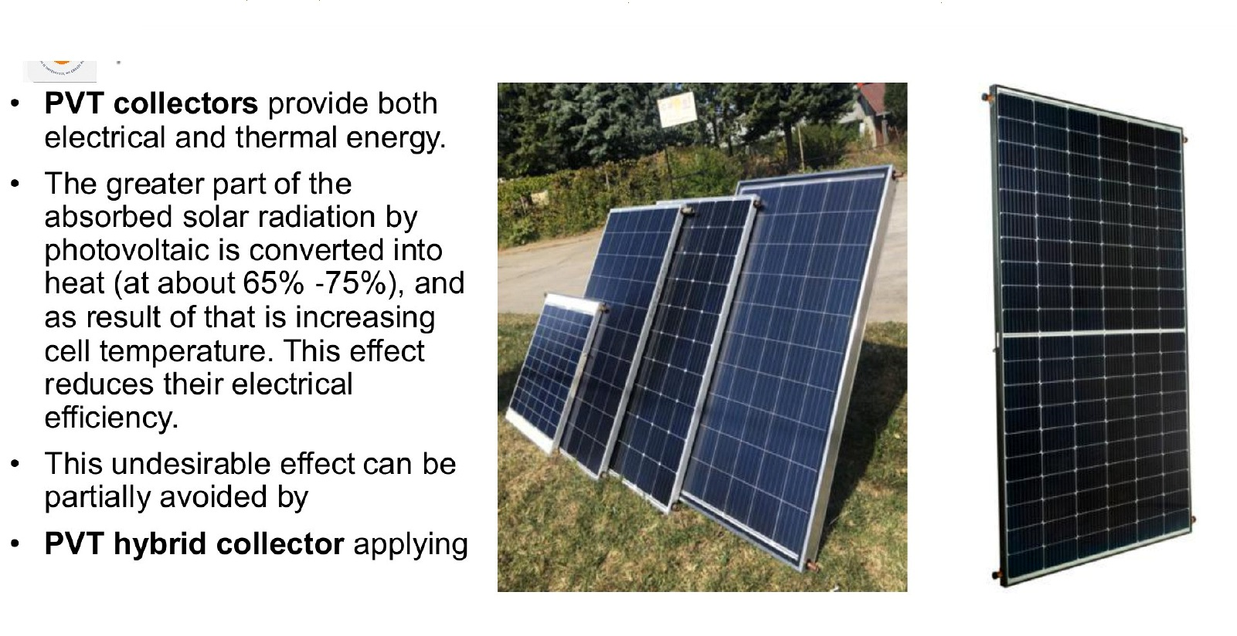
Server Solutions / Plasma PVT Collectors
03 PVT TECHNOLOGY & TESTING
pvt-hybrid.eu • info@pvt-hybrid.eu • +420 774 683 019
12

Slide 13
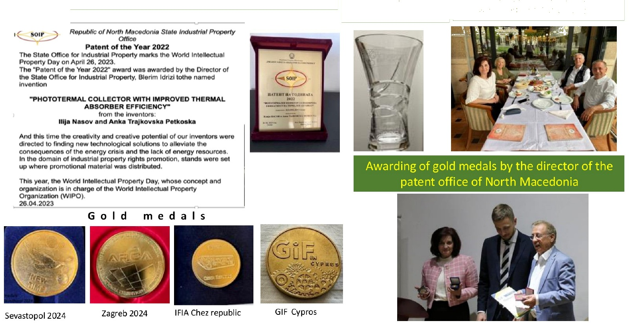
Recognition & Awards
03 PVT TECHNOLOGY & TESTING
pvt-hybrid.eu • info@pvt-hybrid.eu • +420 774 683 019
13

Slide 14
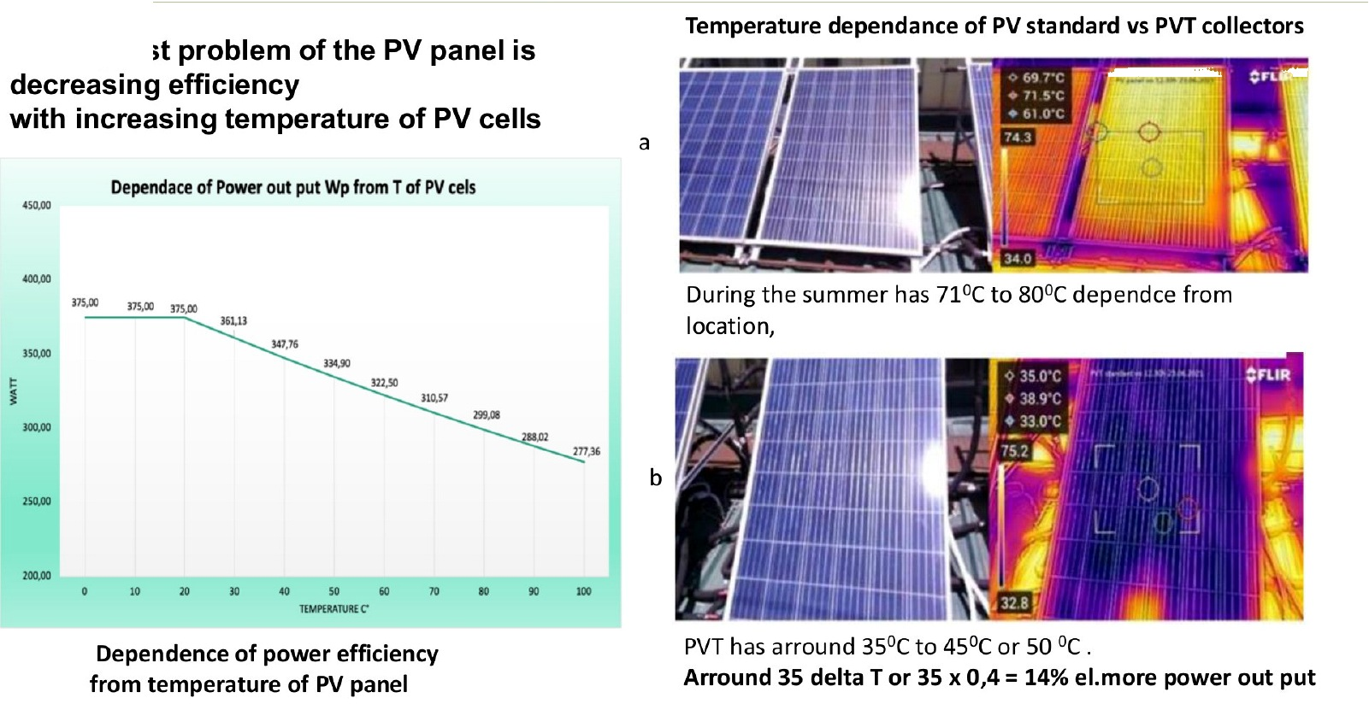
How PVT Works: Electrical and Thermal Output
03 PVT TECHNOLOGY & TESTING
pvt-hybrid.eu • info@pvt-hybrid.eu • +420 774 683 019
14

Slide 15
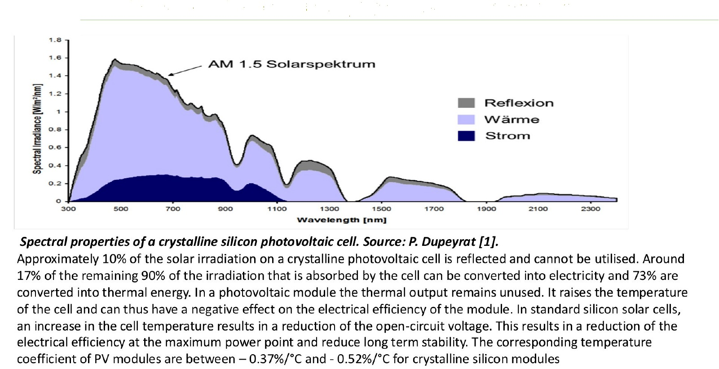
Why Hybrid PVT Matters
03 PVT TECHNOLOGY & TESTING
pvt-hybrid.eu • info@pvt-hybrid.eu • +420 774 683 019
15

Slide 16
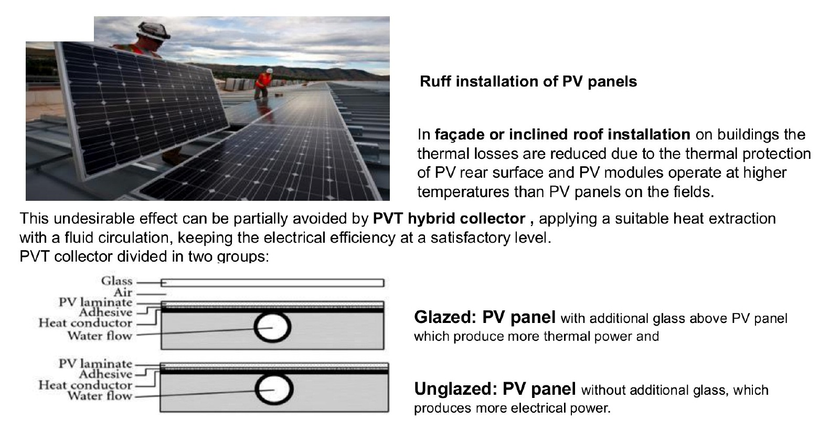
Managing PV Cell Temperature with PVT Cooling
03 PVT TECHNOLOGY & TESTING
pvt-hybrid.eu • info@pvt-hybrid.eu • +420 774 683 019
16

Slide 17
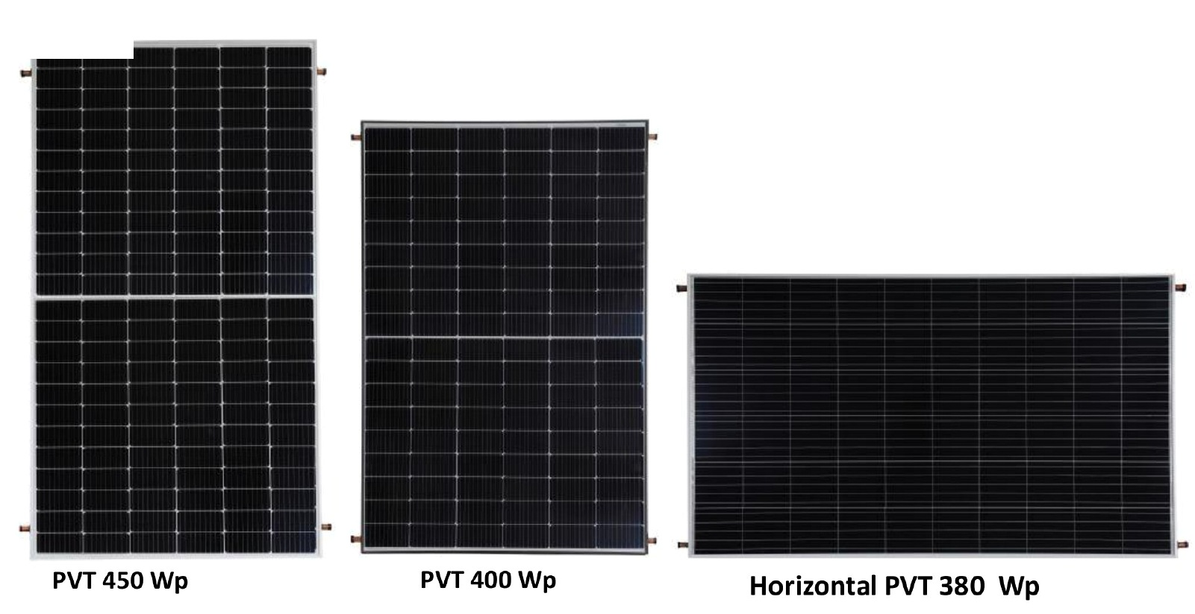
Server Solutions PVT Collectors — Higher Peak Power
03 PVT TECHNOLOGY & TESTING
pvt-hybrid.eu • info@pvt-hybrid.eu • +420 774 683 019
17

Slide 18
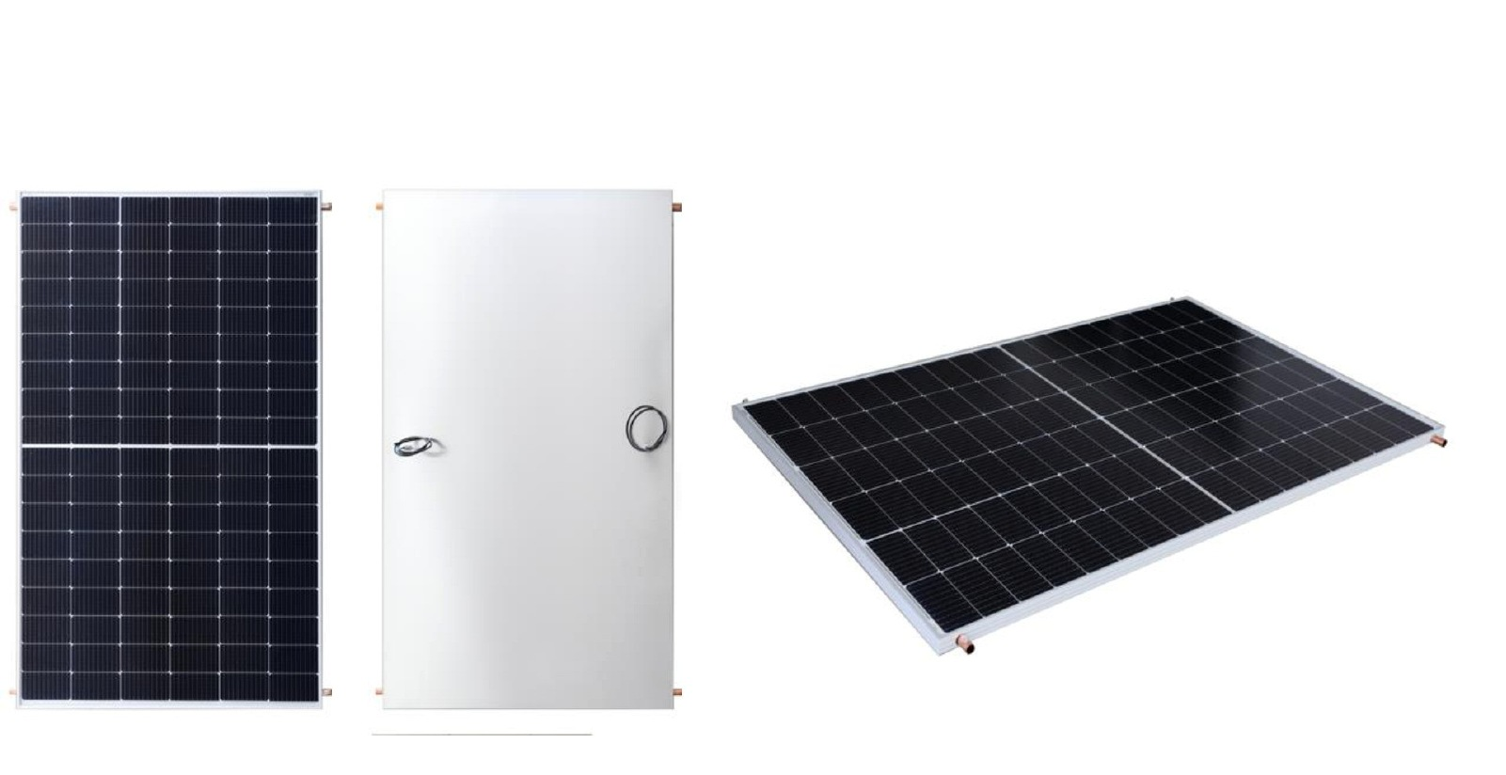
PVT 410 Wp with ML System — Vertical Configuration
03 PVT TECHNOLOGY & TESTING
pvt-hybrid.eu • info@pvt-hybrid.eu • +420 774 683 019
18

Slide 19
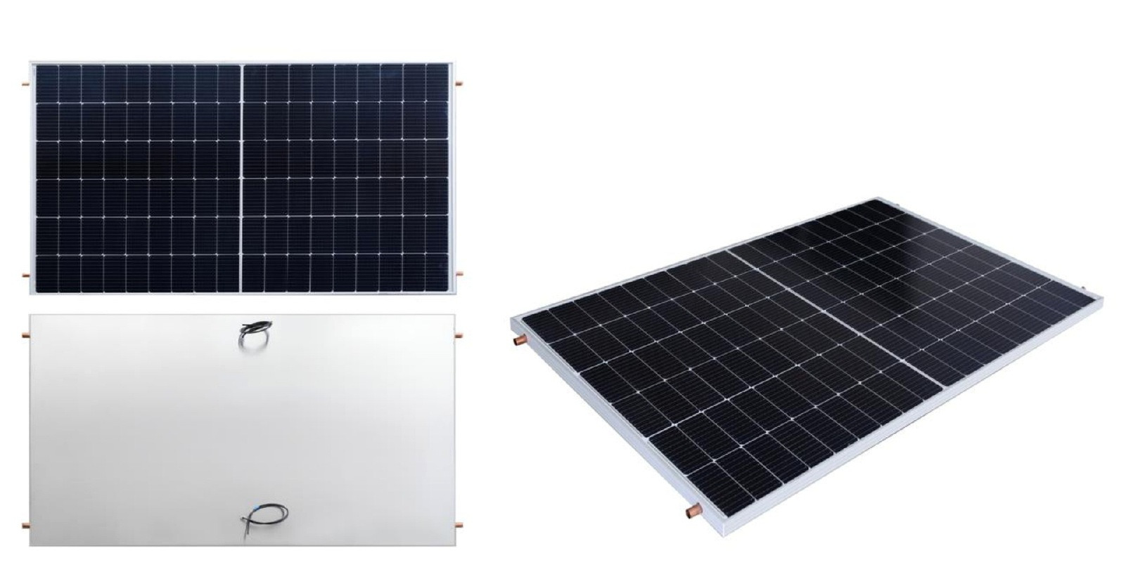
PVT 410 Wp with ML System — Horizontal Configuration
03 PVT TECHNOLOGY & TESTING
pvt-hybrid.eu • info@pvt-hybrid.eu • +420 774 683 019
19

Slide 20
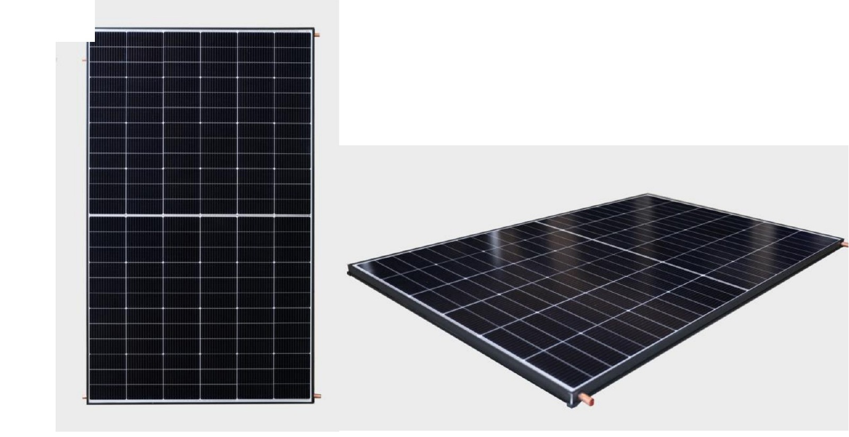
PVT Collector 450 Wp — Front
03 PVT TECHNOLOGY & TESTING
pvt-hybrid.eu • info@pvt-hybrid.eu • +420 774 683 019
20

Slide 21
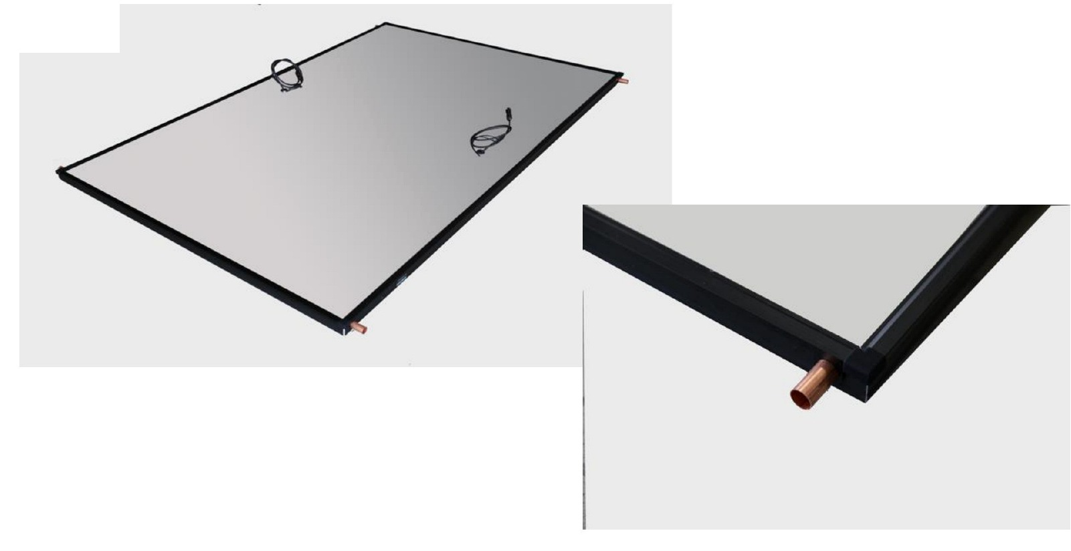
PVT Collector 450 Wp — Rear
03 PVT TECHNOLOGY & TESTING
pvt-hybrid.eu • info@pvt-hybrid.eu • +420 774 683 019
21

Slide 22
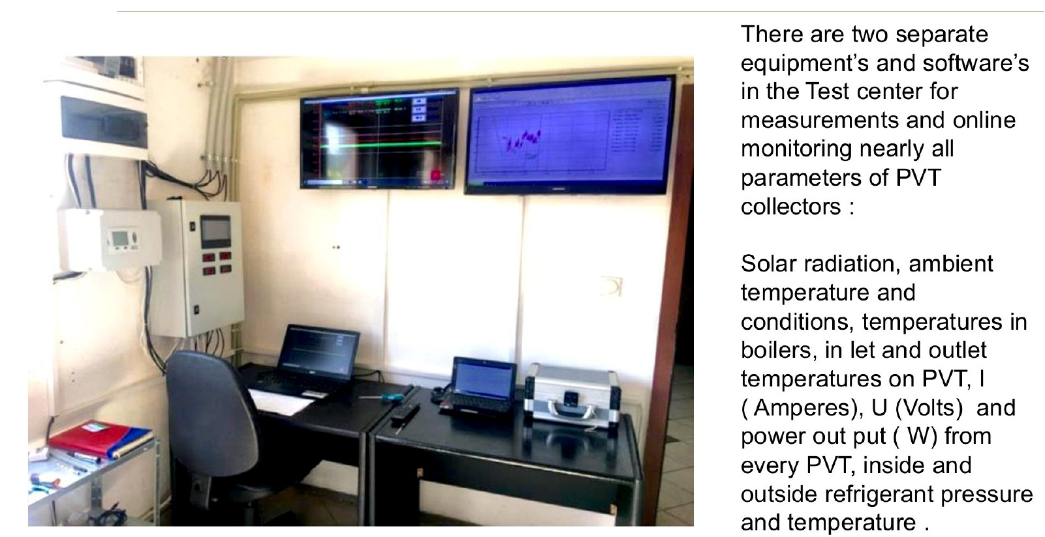
Integrated Test Centre
03 PVT TECHNOLOGY & TESTING
pvt-hybrid.eu • info@pvt-hybrid.eu • +420 774 683 019
22

Slide 23
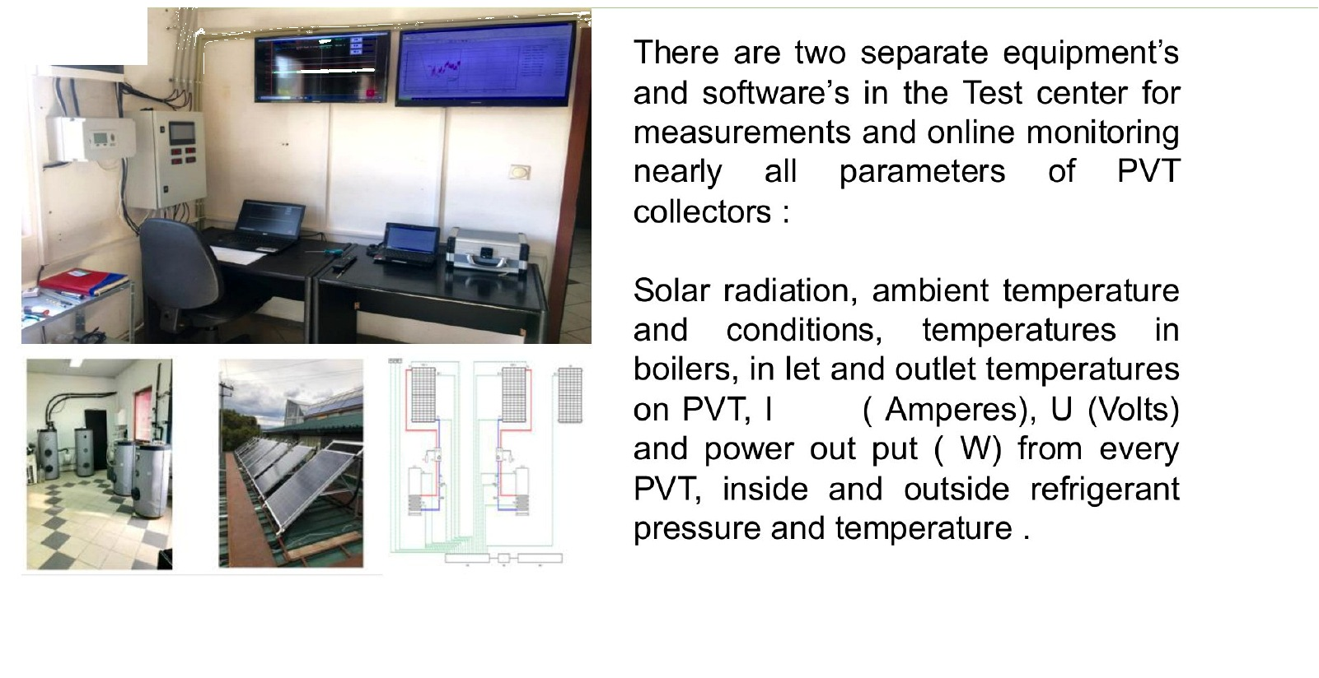
Thermal Testing Equipment
03 PVT TECHNOLOGY & TESTING
pvt-hybrid.eu • info@pvt-hybrid.eu • +420 774 683 019
23

Slide 24
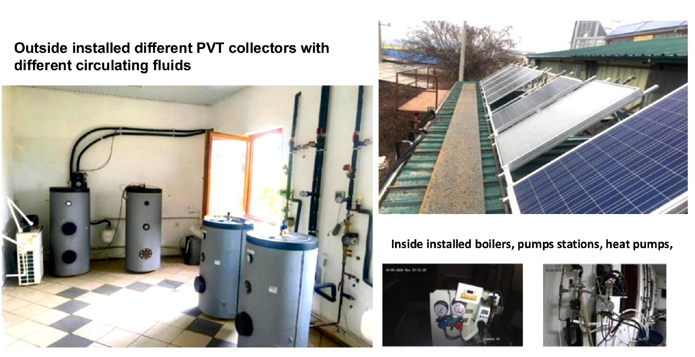
Vehicle-Based Test Centre
03 PVT TECHNOLOGY & TESTING
pvt-hybrid.eu • info@pvt-hybrid.eu • +420 774 683 019
24

Slide 25
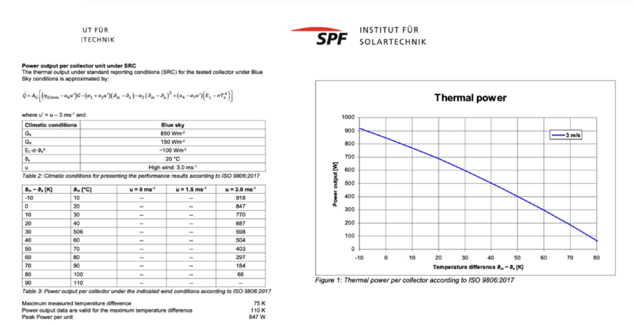
SPF Switzerland Test Results — Glazed PVT Collector
03 PVT TECHNOLOGY & TESTING
INDEPENDENT SPF TESTING
pvt-hybrid.eu • info@pvt-hybrid.eu • +420 774 683 019
25

Slide 26
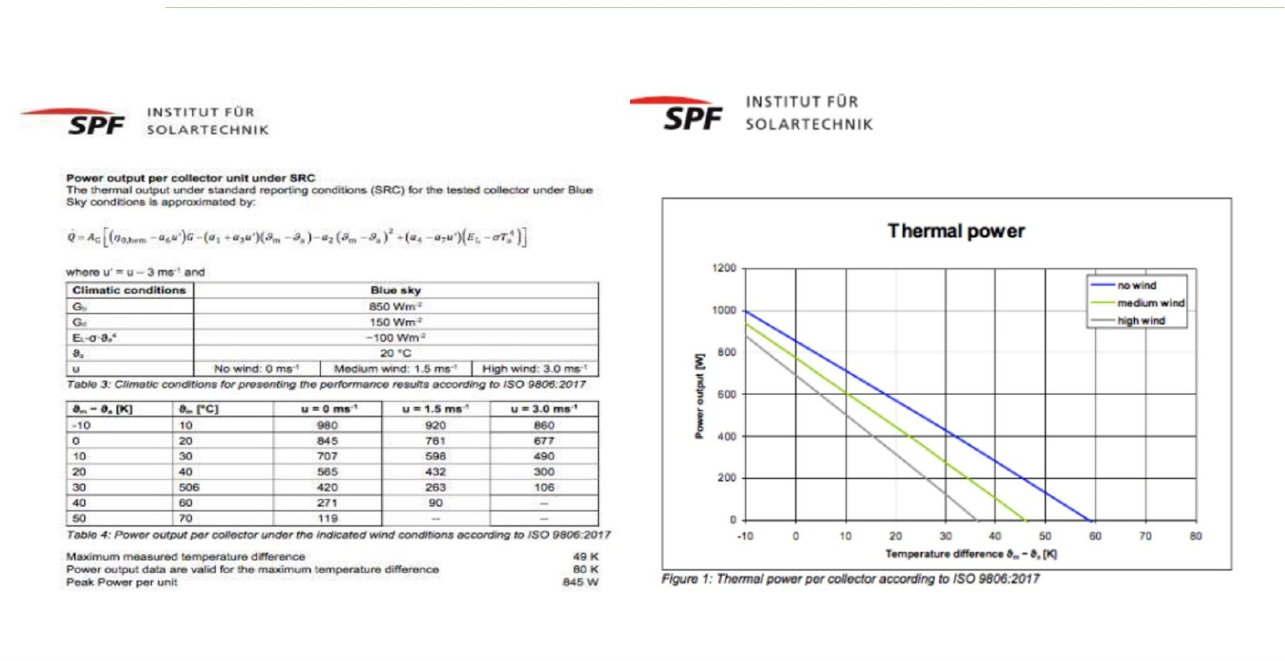
SPF Switzerland Test Results — Unglazed PVT Collector
03 PVT TECHNOLOGY & TESTING
INDEPENDENT SPF TESTING
pvt-hybrid.eu • info@pvt-hybrid.eu • +420 774 683 019
26

Slide 27
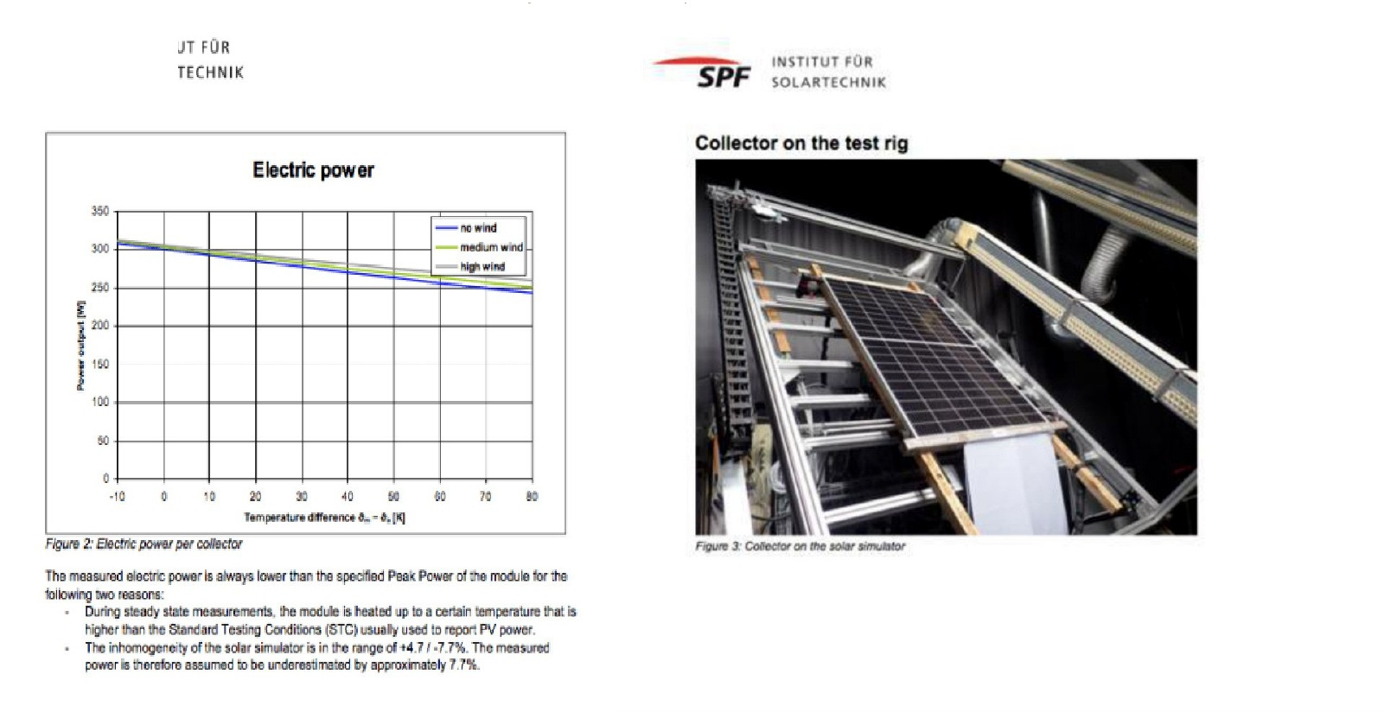
Electrical Power vs. Temperature
03 PVT TECHNOLOGY & TESTING
INDEPENDENT SPF TESTING
pvt-hybrid.eu • info@pvt-hybrid.eu • +420 774 683 019
27

Slide 28
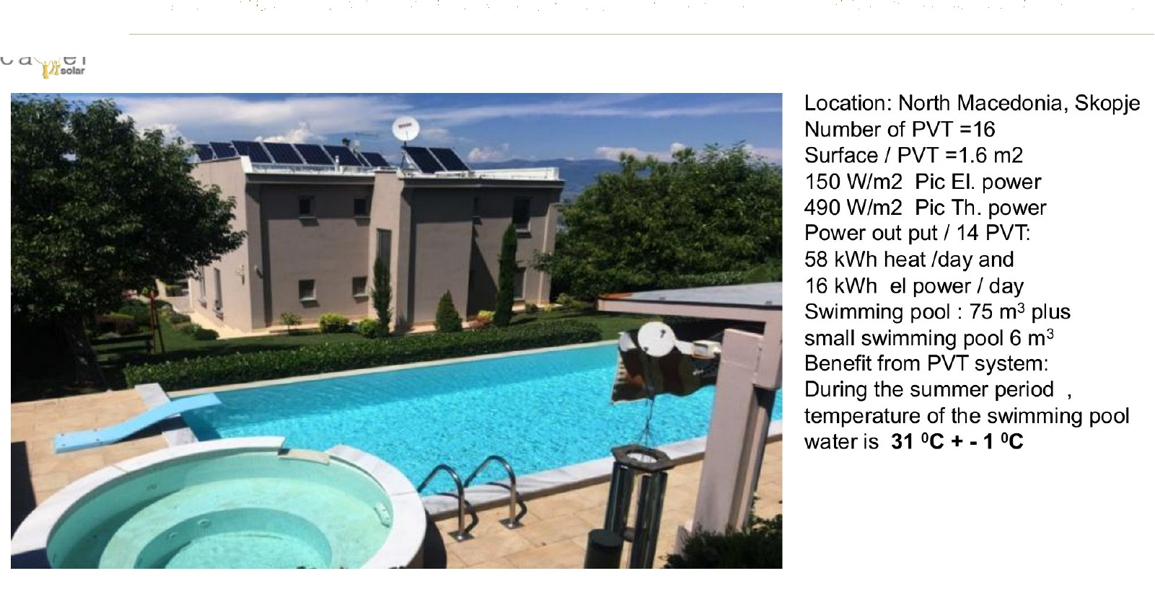
Combined PVT Systems for Pool Heating and Domestic Hot Water
04 REFERENCE PROJECTS
pvt-hybrid.eu • info@pvt-hybrid.eu • +420 774 683 019
28

Slide 29
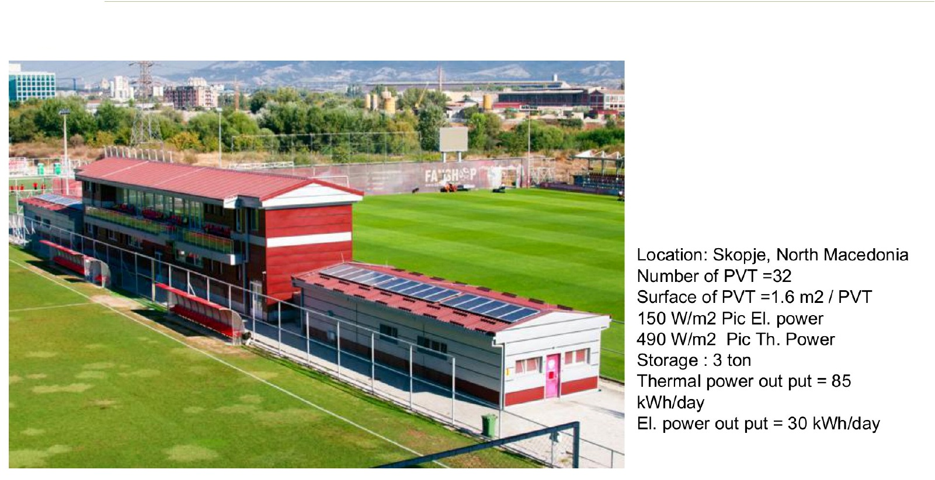
PVT System at a Football Federation Facility
04 REFERENCE PROJECTS
pvt-hybrid.eu • info@pvt-hybrid.eu • +420 774 683 019
29

Slide 30
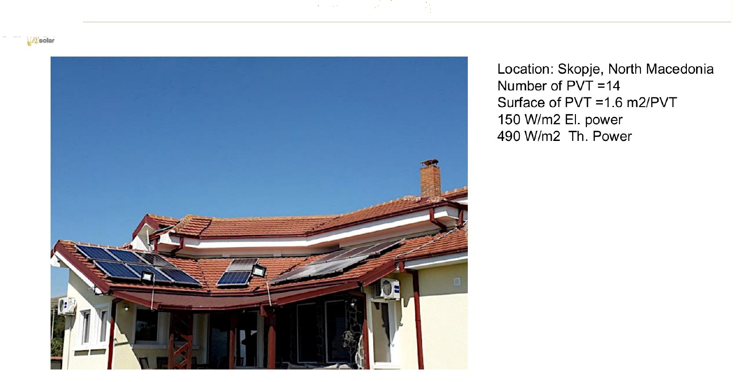
Combined PVT System for Pool & Domestic Hot Water
04 REFERENCE PROJECTS
pvt-hybrid.eu • info@pvt-hybrid.eu • +420 774 683 019
30

Slide 31
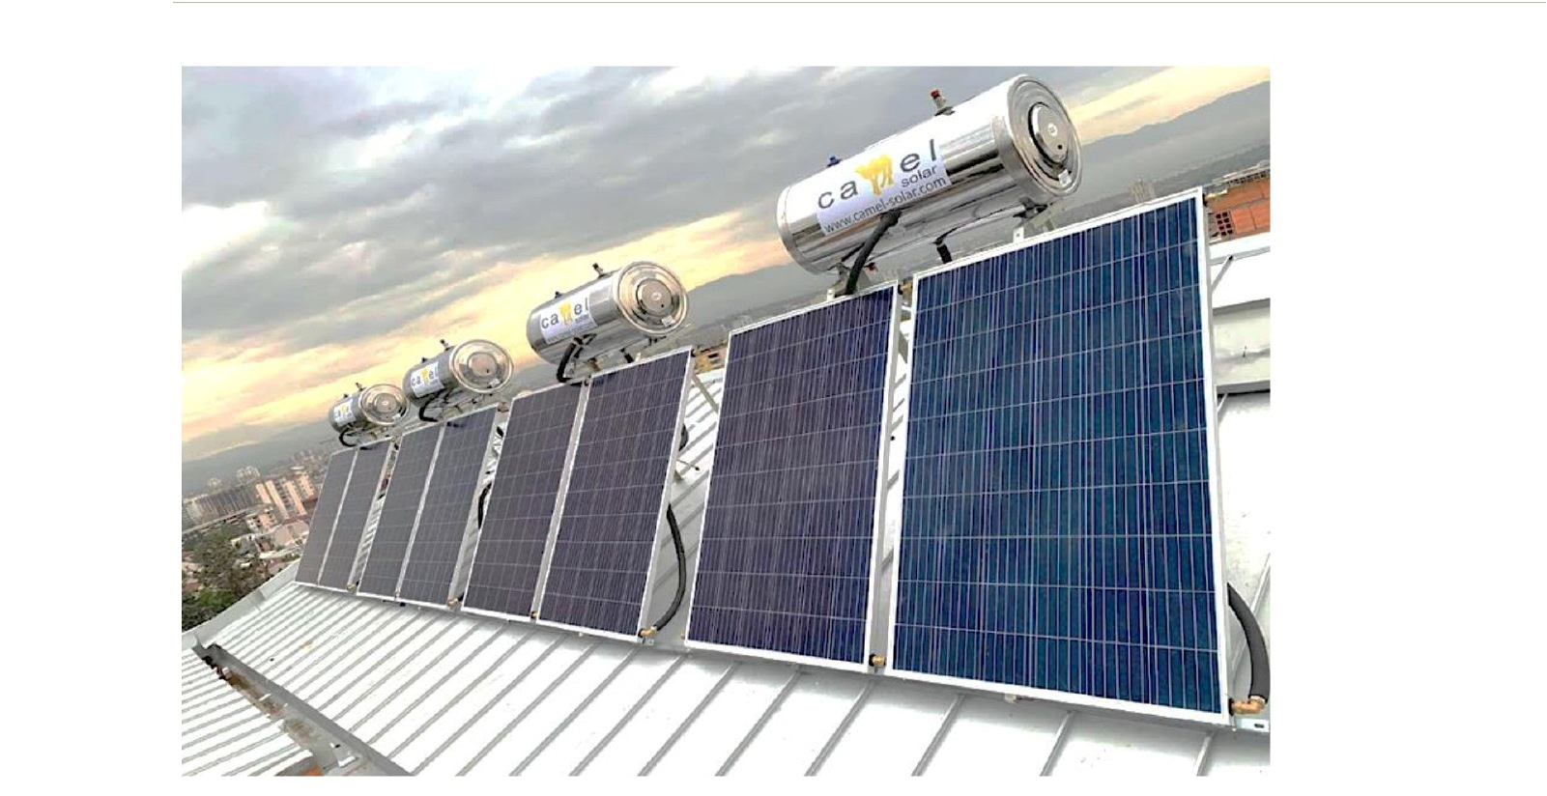
PVT Thermosyphon System for a Residential Building
04 REFERENCE PROJECTS
pvt-hybrid.eu • info@pvt-hybrid.eu • +420 774 683 019
31

Slide 32
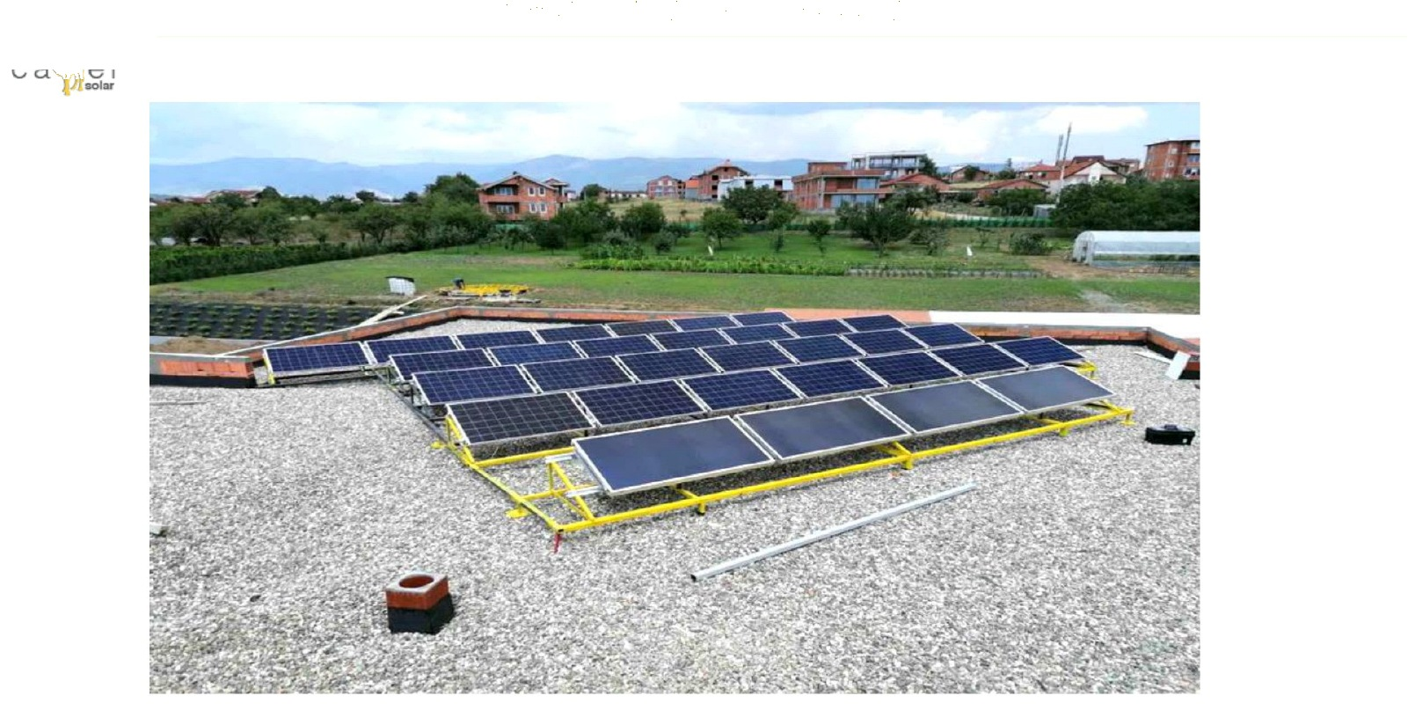
32-Collector PVT System for Pool & Domestic Hot Water
04 REFERENCE PROJECTS
pvt-hybrid.eu • info@pvt-hybrid.eu • +420 774 683 019
32

Slide 33
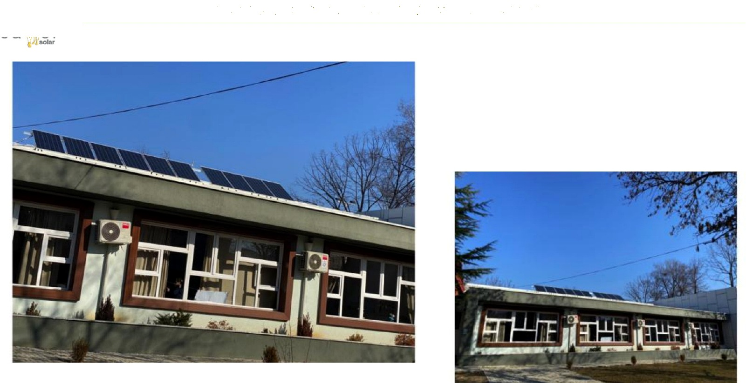
PVT System — Municipal Kindergarten in Skopje
04 REFERENCE PROJECTS
pvt-hybrid.eu • info@pvt-hybrid.eu • +420 774 683 019
33

Slide 34
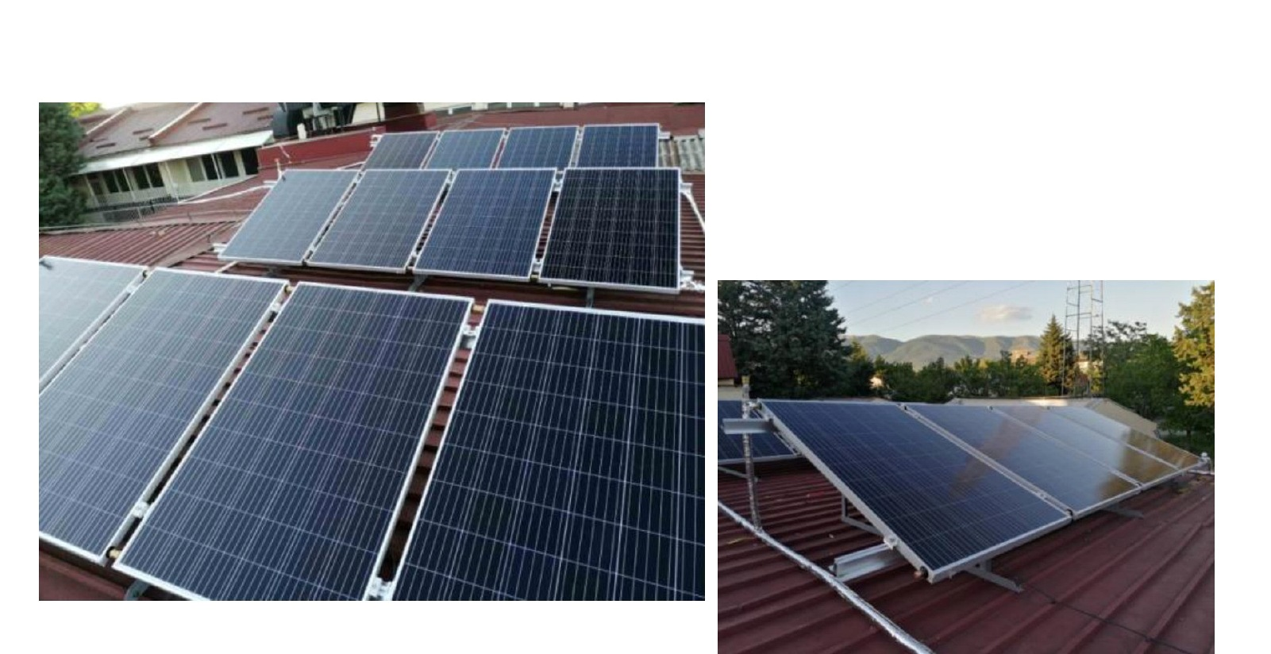
PVT System — Municipal School in Skopje
04 REFERENCE PROJECTS
pvt-hybrid.eu • info@pvt-hybrid.eu • +420 774 683 019
34

Slide 35
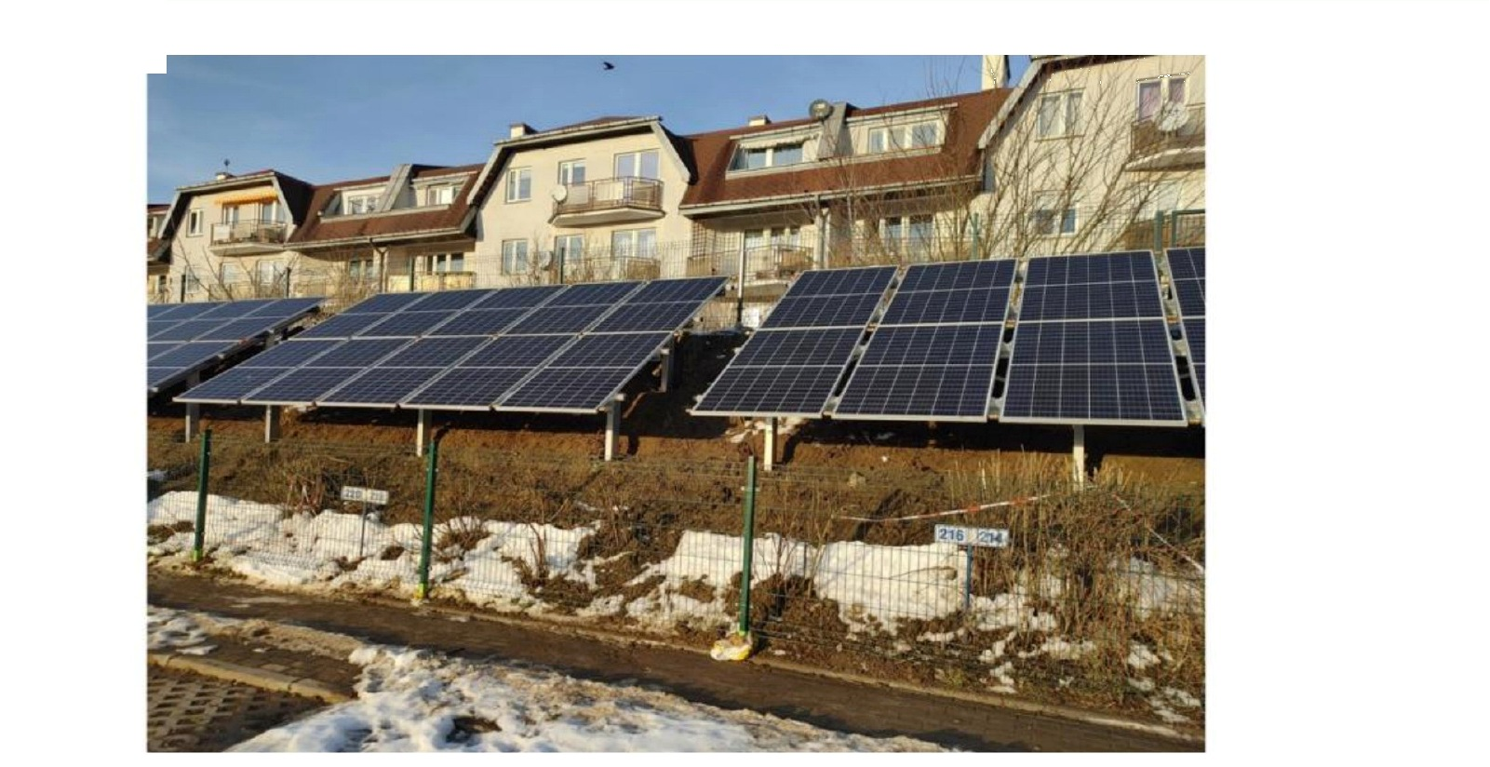
PVT Collectors — Warsaw Public Building
04 REFERENCE PROJECTS
pvt-hybrid.eu • info@pvt-hybrid.eu • +420 774 683 019
35

Slide 36
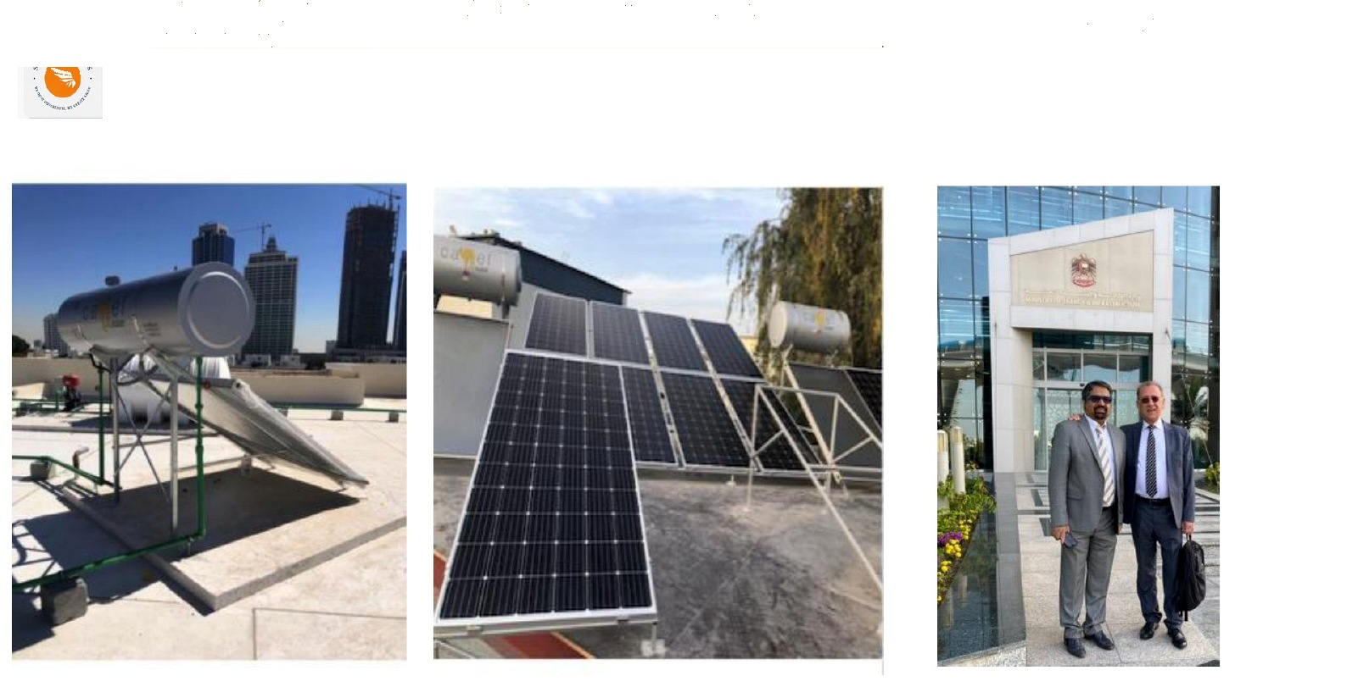
PVT Installation — Hotel in Prague
04 REFERENCE PROJECTS
pvt-hybrid.eu • info@pvt-hybrid.eu • +420 774 683 019
36

Slide 37
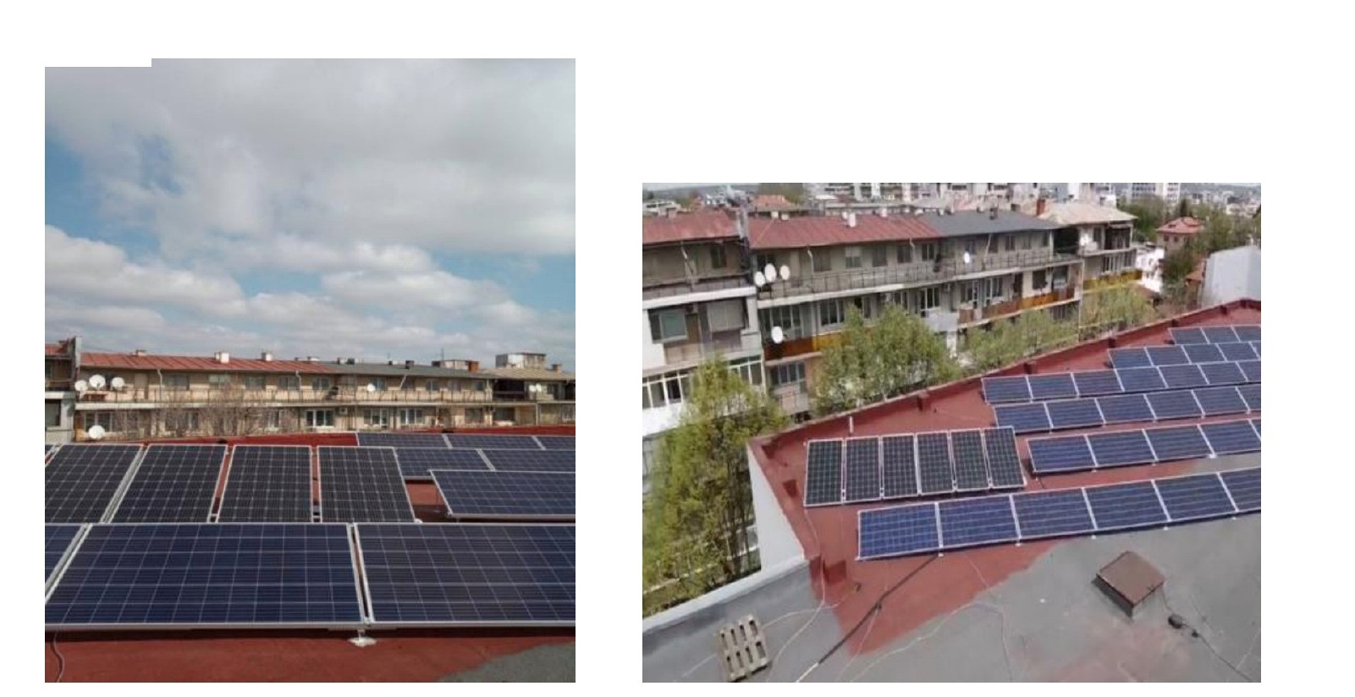
PVT Systems — Kindergartens in Sofia
04 REFERENCE PROJECTS
pvt-hybrid.eu • info@pvt-hybrid.eu • +420 774 683 019
37

Slide 38
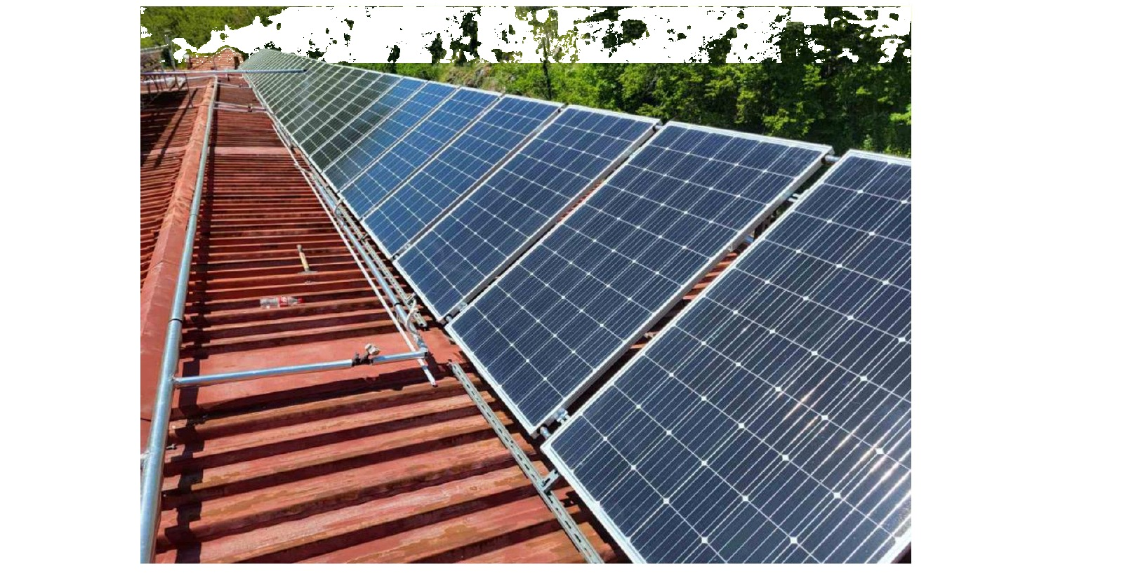
PVT System — Hospital in Sofia
04 REFERENCE PROJECTS
pvt-hybrid.eu • info@pvt-hybrid.eu • +420 774 683 019
38

Slide 39
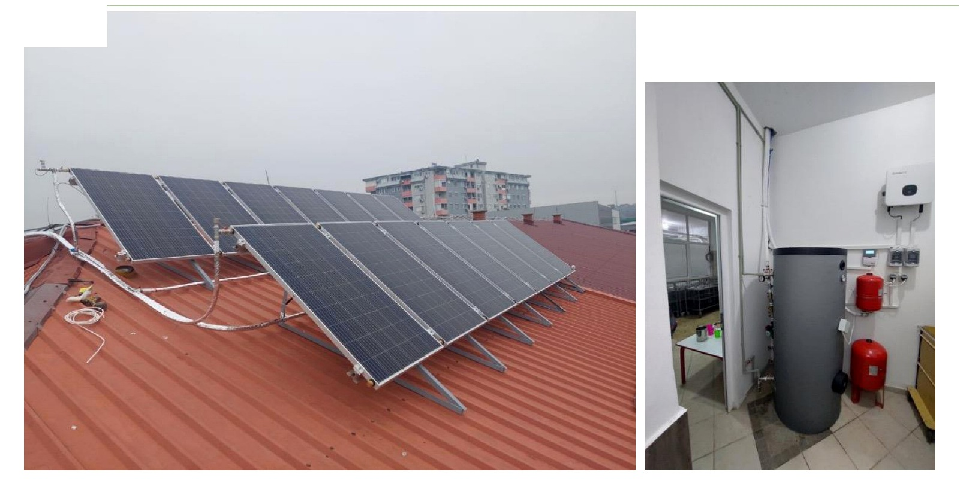
PVT System — Municipal Kindergarten in Ilinden
04 REFERENCE PROJECTS
pvt-hybrid.eu • info@pvt-hybrid.eu • +420 774 683 019
39

Slide 40
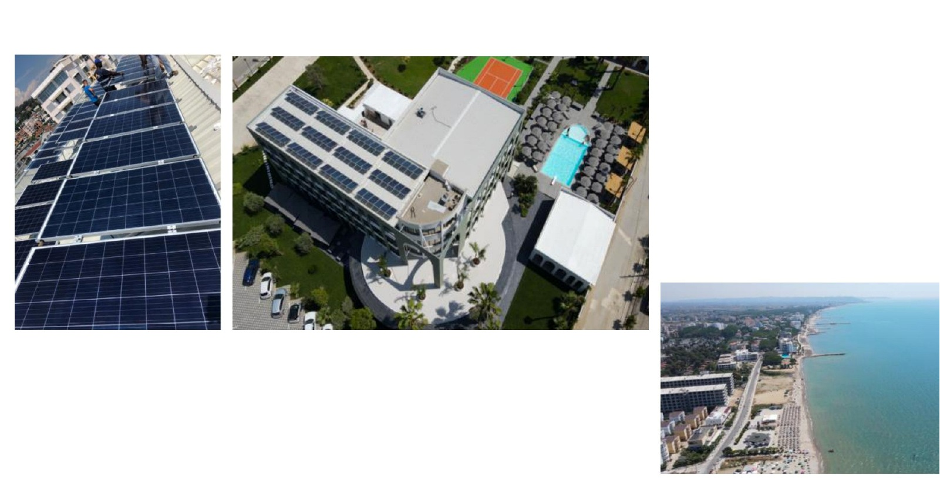
PVT System — Flower Garden Hotel, Durrës
04 REFERENCE PROJECTS
pvt-hybrid.eu • info@pvt-hybrid.eu • +420 774 683 019
40

Slide 41
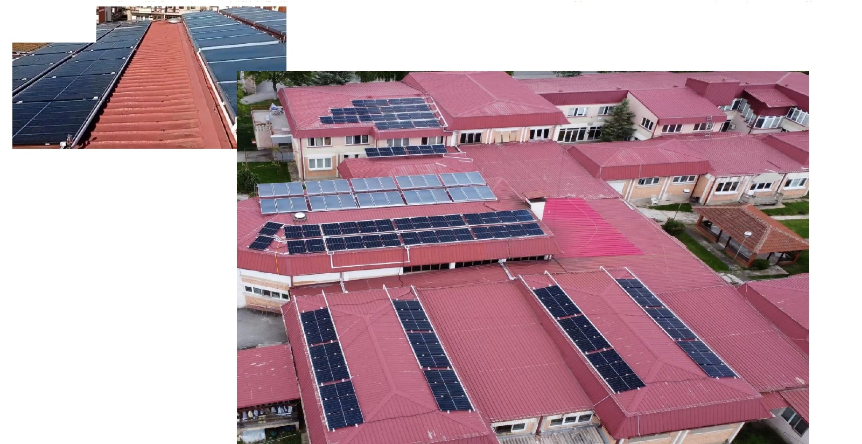
PVT System — Municipal Swimming Pool, Ilinden
04 REFERENCE PROJECTS
pvt-hybrid.eu • info@pvt-hybrid.eu • +420 774 683 019
41

Slide 42
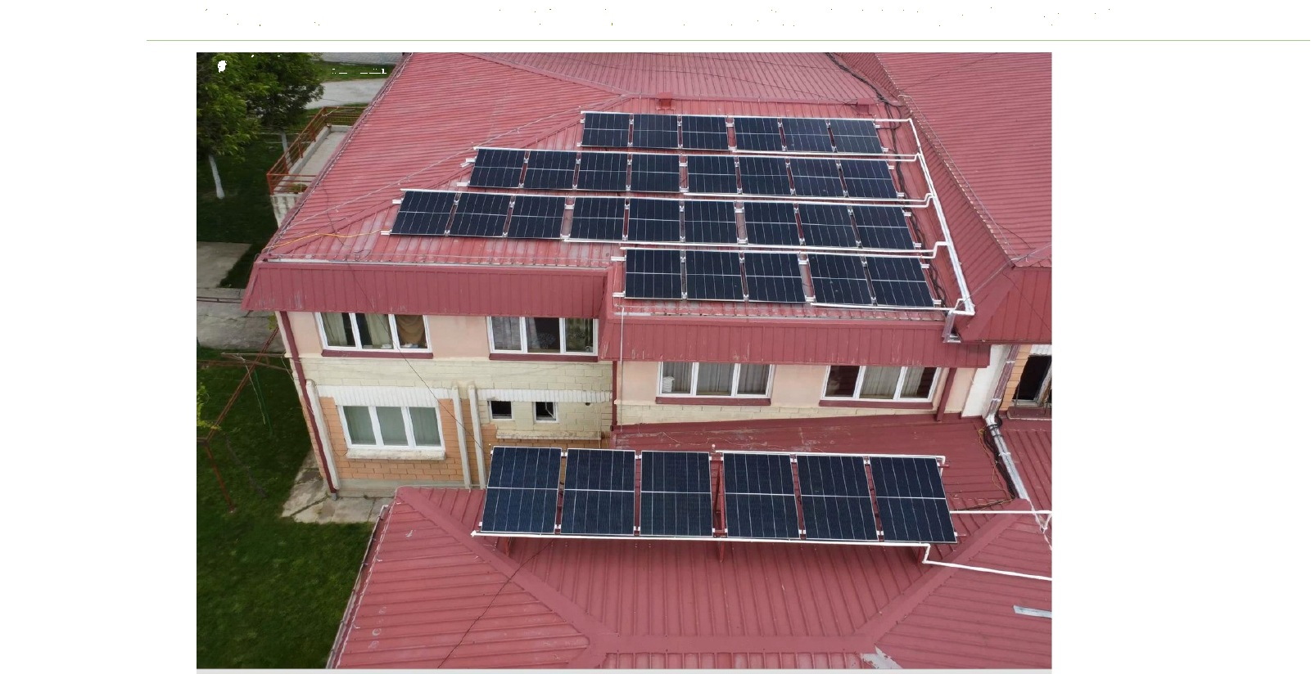
Combined PVT & Solar Thermal System — Nursing Home, Prilep
04 REFERENCE PROJECTS
pvt-hybrid.eu • info@pvt-hybrid.eu • +420 774 683 019
42

Slide 43
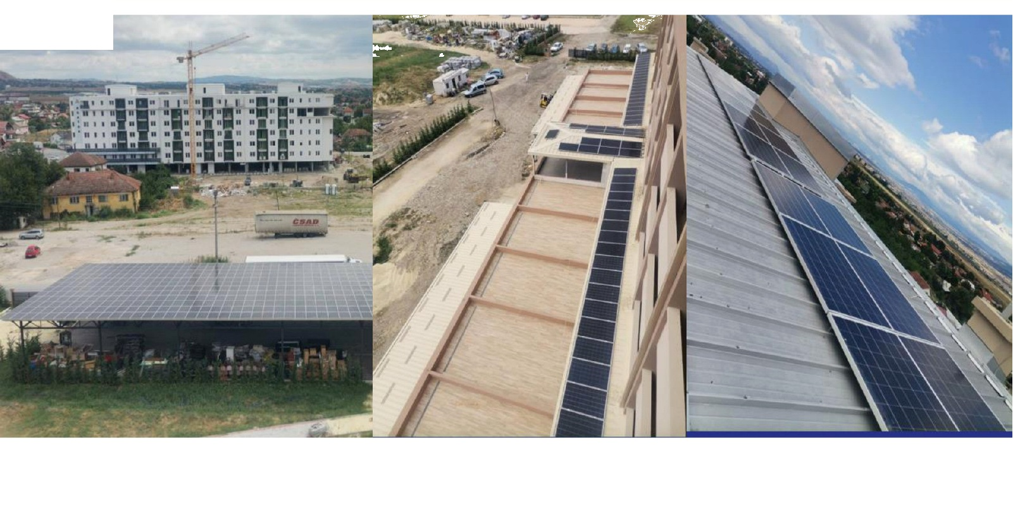
PVT System — Nursing Home, Gazi Baba
04 REFERENCE PROJECTS
pvt-hybrid.eu • info@pvt-hybrid.eu • +420 774 683 019
43

Slide 44
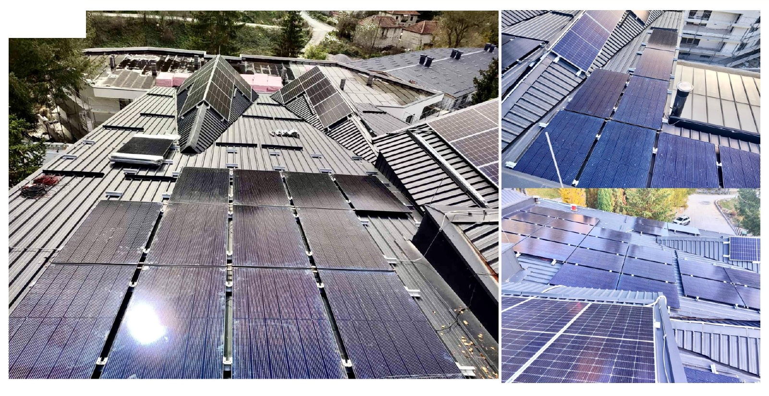
Combined PVT System with Solar Thermal — PVT Hotel, Moscow
04 REFERENCE PROJECTS
pvt-hybrid.eu • info@pvt-hybrid.eu • +420 774 683 019
44

Slide 45
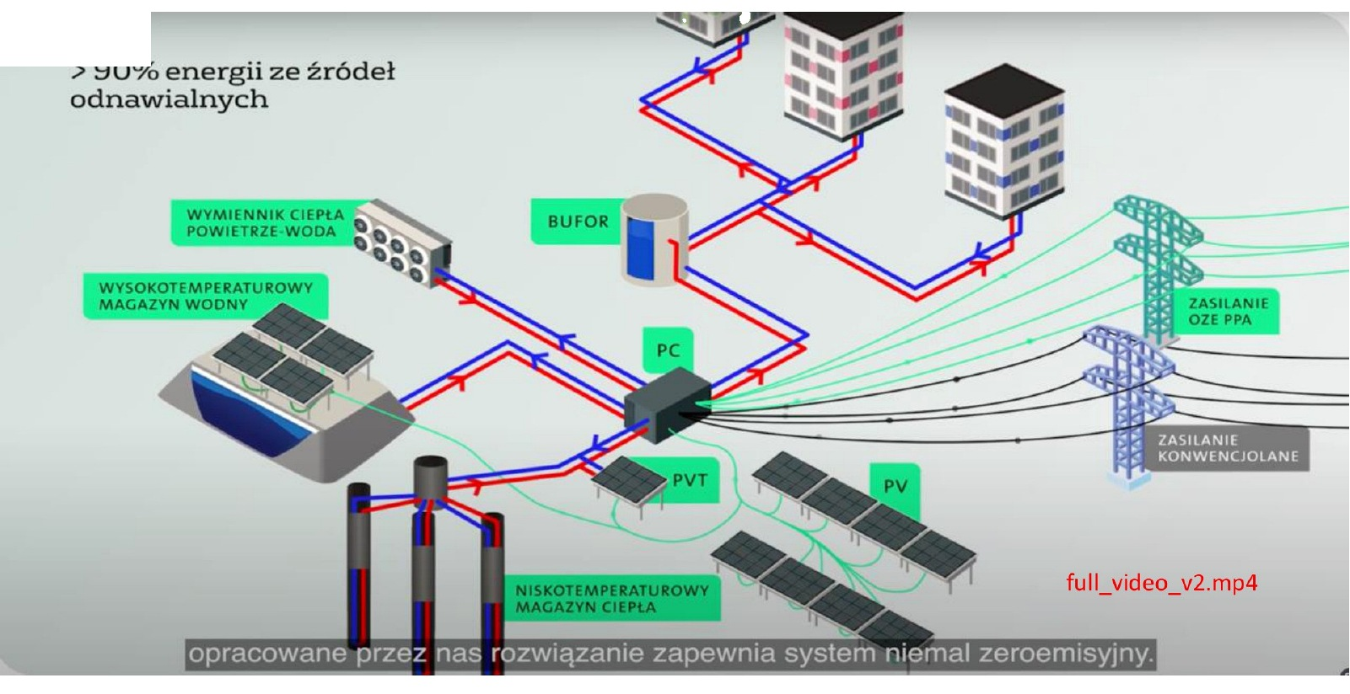
Large-Scale Renewable District Heating — VEOLIA Poland
05 INTEGRATED SYSTEMS & R&D
pvt-hybrid.eu • info@pvt-hybrid.eu • +420 774 683 019
45

Slide 46
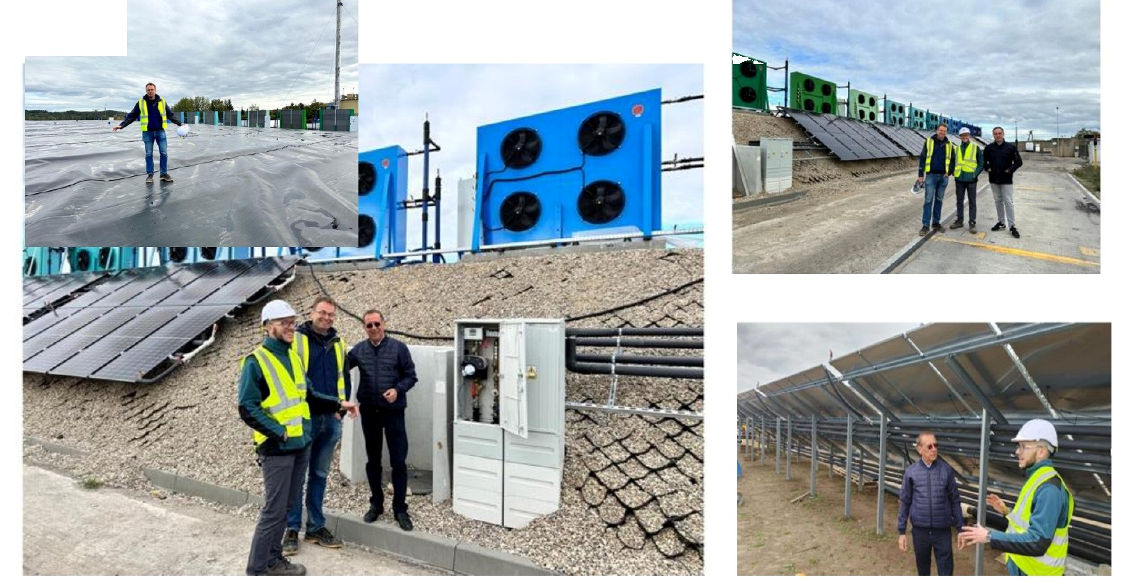
PVT-Assisted Renewable District Heating
05 INTEGRATED SYSTEMS & R&D
pvt-hybrid.eu • info@pvt-hybrid.eu • +420 774 683 019
46

Slide 47
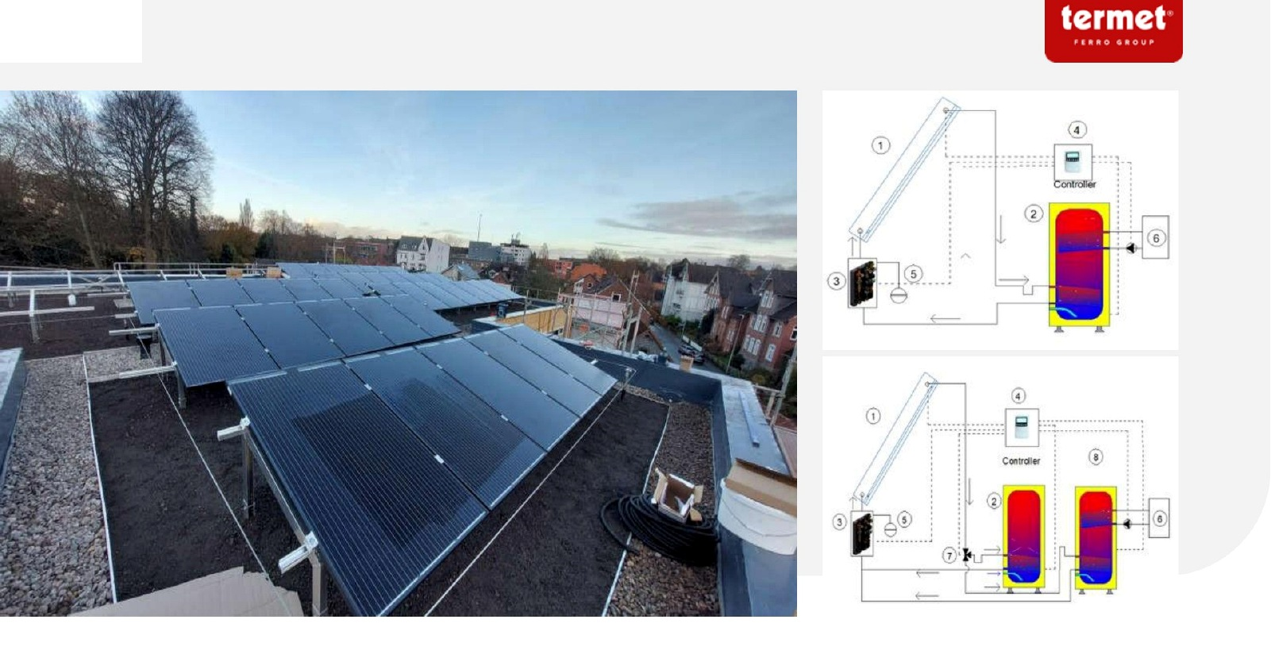
PVT System Integration
05 INTEGRATED SYSTEMS & R&D
pvt-hybrid.eu • info@pvt-hybrid.eu • +420 774 683 019
47

Slide 48
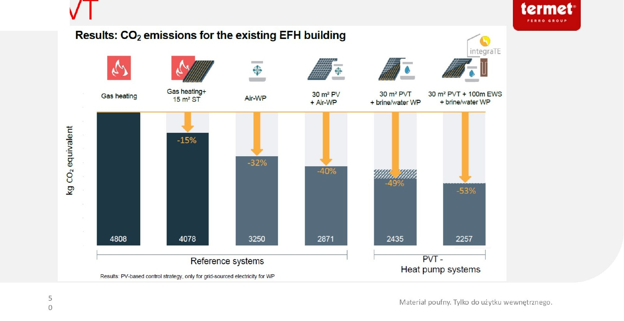
Building Energy System Options
05 INTEGRATED SYSTEMS & R&D
pvt-hybrid.eu • info@pvt-hybrid.eu • +420 774 683 019
48

Slide 49
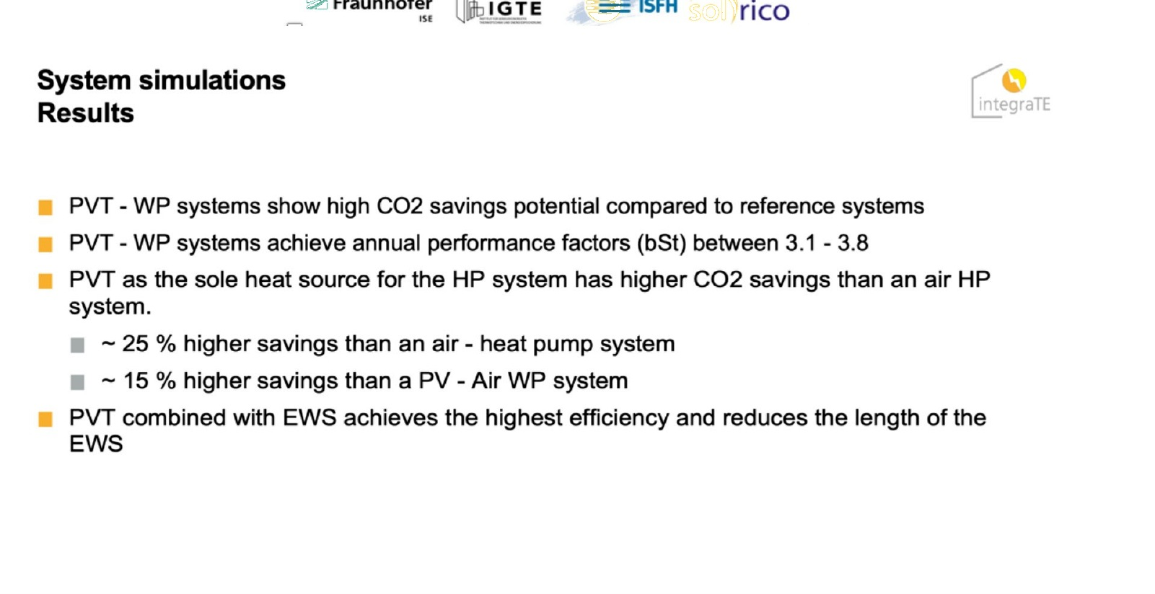
Performance & Simulation Results
05 INTEGRATED SYSTEMS & R&D
pvt-hybrid.eu • info@pvt-hybrid.eu • +420 774 683 019
49

Slide 50
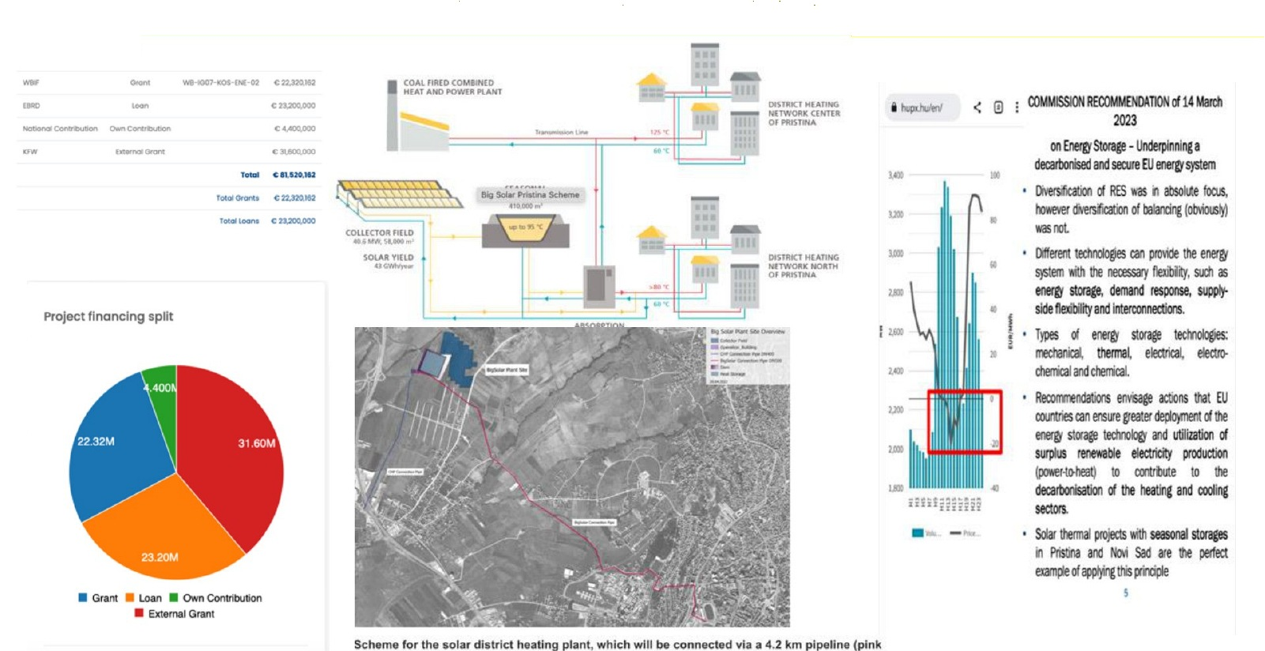
Solar District Heating — Kosovo
05 INTEGRATED SYSTEMS & R&D
pvt-hybrid.eu • info@pvt-hybrid.eu • +420 774 683 019
50

Slide 51
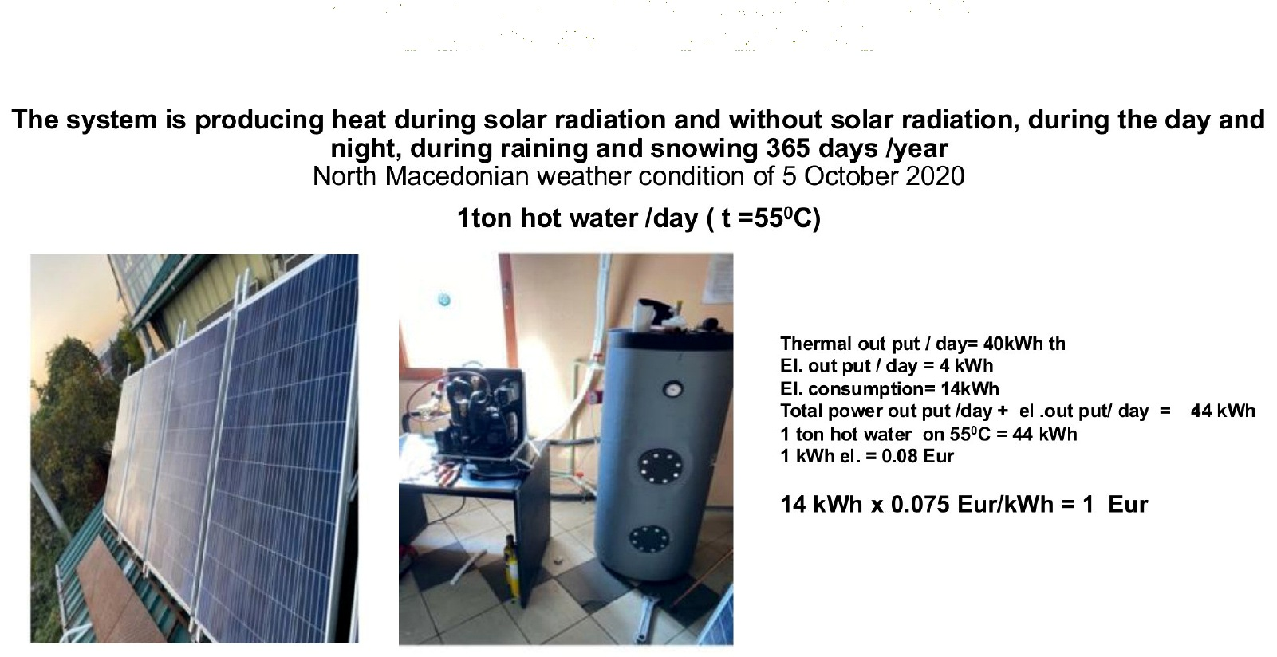
PVT System Installation & Maintenance
05 INTEGRATED SYSTEMS & R&D
pvt-hybrid.eu • info@pvt-hybrid.eu • +420 774 683 019
51

Slide 52
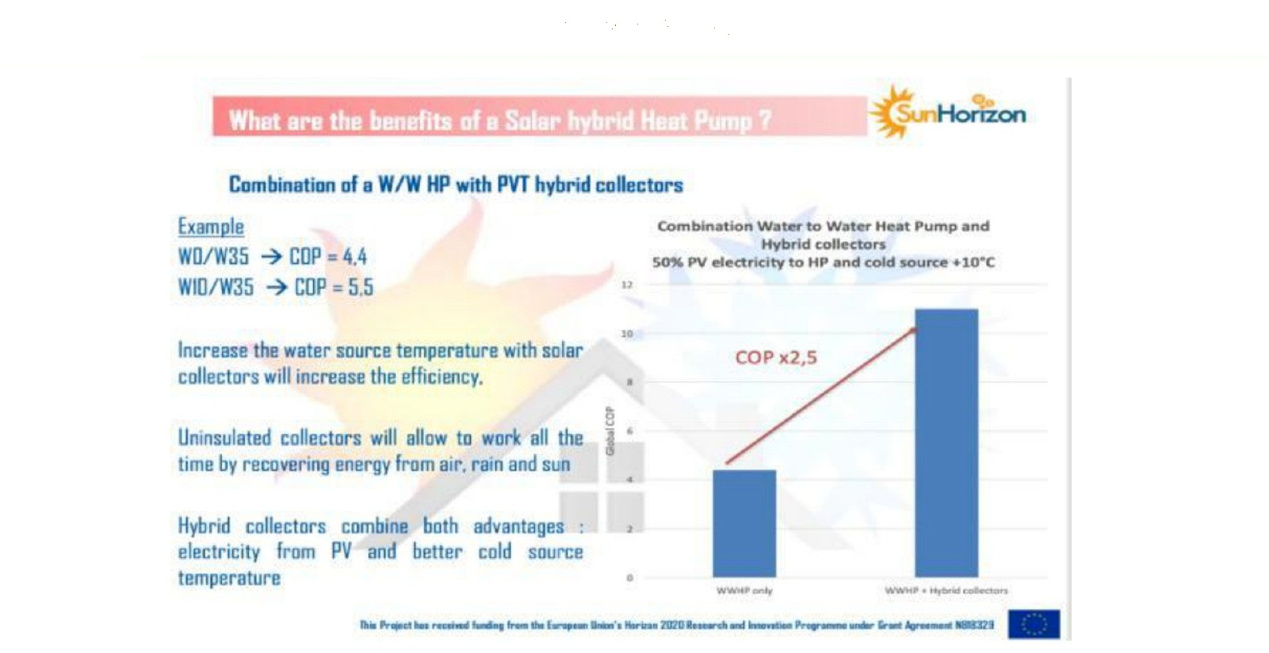
Lessons from the H2020 Project
05 INTEGRATED SYSTEMS & R&D
pvt-hybrid.eu • info@pvt-hybrid.eu • +420 774 683 019
52

Slide 53
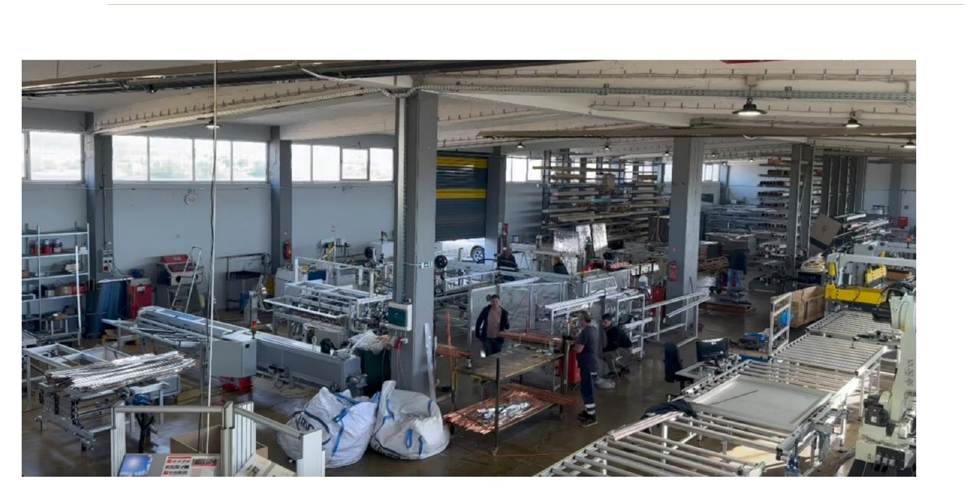
New Automated PVT Production Line
05 INTEGRATED SYSTEMS & R&D
pvt-hybrid.eu • info@pvt-hybrid.eu • +420 774 683 019
53

Slide 54

Designing Integrated Energy Systems
05 INTEGRATED SYSTEMS & R&D
pvt-hybrid.eu • info@pvt-hybrid.eu • +420 774 683 019
54

Slide 55
05
R&D AND
INNOVATION
Scientific collaboration, EU innovation projects and next-generation production.
SERVER SOLUTIONS
pvt-hybrid.eu • info@pvt-hybrid.eu • +420 774 683 019
55

Slide 56

Scientific Collaboration & Research Partners
05 INTEGRATED SYSTEMS & R&D
pvt-hybrid.eu • info@pvt-hybrid.eu • +420 774 683 019
56

Slide 57

EU FP7 & H2020 Innovation Projects
05 INTEGRATED SYSTEMS & R&D
pvt-hybrid.eu • info@pvt-hybrid.eu • +420 774 683 019
57

Slide 58

EU H2020 Project — Server Solutions Partnership
05 INTEGRATED SYSTEMS & R&D
ENSNARE: Nearly Zero-Energy Building
pvt-hybrid.eu • info@pvt-hybrid.eu • +420 774 683 019
58

Slide 59

EU Horizon 2020 Promotional Material — ENSNARE
05 INTEGRATED SYSTEMS & R&D
ENSNARE: Integrated Renovation & PVT Façade Systems
pvt-hybrid.eu • info@pvt-hybrid.eu • +420 774 683 019
59

Slide 60


